Slide 1
The OSHA Model of Process Safety Management
Donald J. Connolley, CSP
Process Safety Group Manager
aeSolutions

Slide 2
Process Safety
CCPS: A disciplined framework for managing the integrity of operating systems and processes handling hazardous substances by applying good design principles, engineering, and operating practices. It deals with the prevention and control of incidents that have the potential to release hazardous materials or energy. Such incidents can cause toxic effects, fire, or explosion and could ultimately result in serious injuries, property damage, lost production, and environmental impact.
Simple version: Keep it in the pipe.

Slide 3
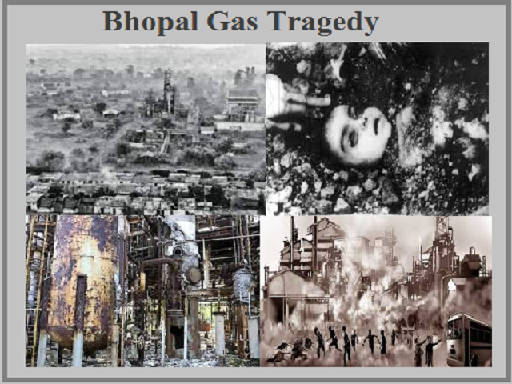
OSHA Process Safety Management Standard
29 CFR 1910.119
Process Safety Management of Highly Hazardous Chemicals
Issued February 24, 1992 (57 FR 6356)
Effective May 26, 1992
Driver
Clean Air Act Amendments of 1990
Several incidents involving Highly Hazardous Chemicals that resulted in multiple fatalities
Purpose: “This section contains requirements for preventing or minimizing the consequences of catastrophic releases of toxic, reactive, flammable, or explosive chemicals. These releases may result in toxic, fire or explosion hazards.”
Performance standard

Slide 4
14 Elements
Application
Employee Participation
Process Safety Information
Process Hazard Analysis
Operating Procedures
Training
Contractors
Pre-Startup Safety Review
Mechanical Integrity
Hot Work Permit
Management of Change
Incident Investigation
Emergency Planning and Response
Compliance Audits
Trade Secrets
Definitions (Between Application and Employee Participation)
Appendix A (Mandatory): List of Highly Hazardous Chemicals, Toxics and Reactives

Slide 5
1910.119(a) Application
Applies to:
Process which involves a chemical list in Appendix A at or above the threshold quantity
10,000 lbs or more of flammables in one location
Category 1 flammable gas as defined in 1910.1200(c), OR
Flammable liquid with flash point below 100ºF
Except:
Hydrocarbon fuels used solely for workplace consumption, if not a part of a covered process
Flammable liquids with a flash point below 100oF stored in atmospheric tanks and kept below their normal boiling point without chilling or refrigeration
Does not apply to
Retail facilities
Oil or gas well drilling or servicing operations
Normally unoccupied remote facilities

Slide 6
Application
Nuance – definition of “Process”
Any activity involving a highly hazardous chemical (HHC) including any use, storage, manufacturing, handling, or the on-site movement of such chemicals, or combination of these activities.
Single process considered to be:
Any group of vessels which are interconnected
Separate vessels which are located such that a highly hazardous chemical could be involved in a potential release
Many OSHA interpretations
Notable rulings:
Meer Decision (1997) – PSM coverage does not include flammables in atmospheric tanks even if interconnected with a covered process
Akzo Nobel Interpretation (1997) – Limits of a covered process
Wynnewood Refining (October 27, 2020)
Interconnectivity extends to utilities
“A vessel does not actually need to contain a highly hazardous chemical to be subject to PSM as long as the vessel is interconnected to a vessel that is subject to the standard.”

Slide 7
191.119(c) Employee Participation
Purpose – That employees have the information they need to understand the process hazards to which they potentially can be exposed
Requirements
Written employee participation plan
“Employers shall consult with employees and their representatives” on
Conduct and development of PHAs
Development of the other elements of the standard
Access by “employees and their representatives” to PHAs and “all other information required to be developed under this standard”

Slide 8
1910-119(d) Process Safety Information (PSI)
Purpose – Employees have the information to be able to understand and analyze the hazards of the process
OSHA divides PSI into three types – Information pertaining to:
Hazards of the Process
Technology of the Process
Equipment in the Process
Required to be developed or compiled prior to conducting any PHA required by the standard

Slide 9
PSI – Hazards of the Process
Toxicity information
Permissible exposure limits
Physical data
Reactivity data
Corrosivity data
Thermal and chemical stability data
Hazardous effects of inadvertent mixing of different materials that could foreseeably occur

Slide 10
PSI – Technology of the Process
Block Flow Diagram or “simplified” Process Flow Diagram
Process Chemistry
Maximum Intended Inventory
Safe Upper and Lower Limits for process parameters
Evaluation of the consequences of deviations from Safe Upper and Lower Limits
If the original technical information no longer exists, can be developed in conjunction with the PHA “in sufficient detail to support that analysis”

Slide 11
PSI – Equipment in the Process
Materials of Construction
Piping and Instrument Diagrams (P&IDs)
Electrical Classification
Relief System Design and Design Basis
Ventilation System Design
Design Codes and Standards Employed
Material and Energy Balances for processes built after May 26, 1992
Safety Systems

Slide 12
PSI
Must document that equipment complies with RAGAGEP (Recognized and Generally Accepted Good Engineering Practices)
For equipment designed and construction to earlier versions of codes, standards, or practices, must “determine and document that the equipment is designed, maintained, inspected, tested, and operating in a safe manner”

Slide 13
1910.119(e) Process Hazard Analysis (PHA)
Purpose – Identify and control potential process hazards
Must perform an initial PHA on covered processes
PHA must be “appropriate to the complexity of the process”
PHA “shall identify, evaluate, and control the hazards involved in the process”
Acceptable PHA methods:
What-If
Checklist
What-If/Checklist
HAZOP (HAZards and OPerability)
FMEA (Failure Modes and Effects Analysis)
FTA (Fault Tree Analysis)
“An appropriate equivalent methodology”

Slide 14
PHA Must Address
Hazards of the process
“Identification of any previous incident which had a likely potential for catastrophic consequences in the workplace”
Engineering and administrative controls applicable to the hazards “and their interrelationships”
Consequences of failure of engineering and administrative controls
Facility siting
Human factors
“A qualitative evaluation of a range of the possible safety and health effects of failure of controls on employees in the workplace”

Slide 15
PHAs
PHA Team
Expertise in engineering and process operations
Include at least one employee with experience and knowledge specific to the process
One team member knowledgeable in the PHA methodology
Recommendation follow-up system
Recommendations resolved “in a timely manner”
Resolution documented
Actions to be taken documented
Actions completed “as soon as possible”
Written schedule of when actions to be completed
Actions communicated to “operating, maintenance and other employees whose work assignments are in the process and who may be affected by the recommendations or actions”
PHAs revalidated at least every 5 years
PHAs and revalidations/updates retained for the life of the process

Slide 16
1910.119(f) Operating Procedures (SOPs)
Purpose – Operating procedures exist by which employees who operate or maintain the process can safely do so
Develop and implement written operating procedures
Provide clear instructions for safely conducting activities involved in each covered process
Consistent with the PSI
Must be readily accessible to employees who work in or maintain a covered process
Reviewed as often as necessary to assure they reflect current operating practice
Certified annually that the operating procedures are current and accurate

Slide 17
SOPs Must Address
Steps for each operating phase
Initial startup
Normal operations
Temporary operations
Emergency shutdown, including
Conditions under which is required
Assignment of responsibilities
Emergency Operations
Normal Shutdown
Startup following a turnaround or after an emergency shutdown

Slide 18
SOPs Must Address (continued)
Operating limits
Consequences of deviation from operating limits
Steps required to correct or avoid deviation
Safety and health considerations
Chemicals used in the process
Properties
Hazards
Precautions to prevent exposure
Control measures if exposed
Quality control for raw materials and hazardous chemical inventories
Safety Systems and their functions

Slide 19
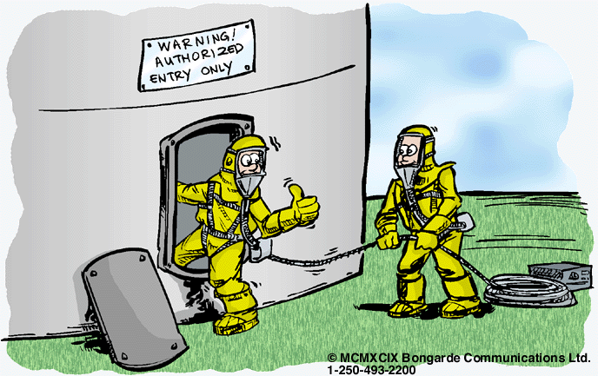
SOPs – Safe Work Practices
Develop and implement
Control of hazards
Lockout/Tagout
Confined Space Entry
Equipment opening (aka Line Break, First Break)
“Control over entrance into a facility by maintenance, contractor, laboratory, or other support personnel
Apply to own employees and contractor employees

Slide 20
1910.119(g) Training
Purpose – Employees operating a covered process are trained to do so
Initial training required prior to operating a covered process
Overview of the process
SOPs
Include emphasis on
Specific safety and health hazards
Emergency operations including shutdown
Safe Work Practices applicable to the employee’s job tasks
Refresher training
At least every 3 years
Determine frequency of refresher training in consultation with employees involved in operating the process
Training documentation
Identity of the employee
Date of training
Means used to verify the training was understood

Slide 21
1910.119(h) Contractors
Purpose
Qualified contractors are used
Contractor employees are aware of the process hazards to which they can potentially be exposed
There is proper supervision over the contractors and their work
Applies to contractors who perform
Maintenance or repair
Turnaround
Major renovation
Specialty work
On or adjacent to a covered process
Does not apply to incidental services (e.g. janitorial, food and drink services, laundry, delivery)

Slide 22
Contractors – Employer Responsibilities
Include contractor safety programs and performance in contractor selection
Inform contract employers of know fire, explosion, toxic hazards related to the contractor’s work and the covered process(es)
Explain to contract employers the applicable provisions of the ER plan
Develop and implement SWP for control of entrance, presence and exit of contractors in covered process areas
Periodically evaluate the performance of contract employers in fulfilling their responsibilities
Maintain a contract employee injury and illness log related to their work in process areas

Slide 23
Contractors – Contractor Employer Responsibilities
Assure their employees are trained in the work practices necessary to perform their job
Assure their employees receive training
In the potential fire, explosion, and toxic release hazards related to their job
Applicable provisions of the ER plan
Document the training, including the means to verify the training is understood
Assure their employees follow the safety rules, including SWP
Advise the facility of any unique hazards presented by, or found during, the contractor’s work

Slide 24
1910.119(i) Pre-Startup Safety Review (PSSR)
Purpose – Verify that a covered process is safe to start up
Application
New or modified covered process
When the change is significant enough to require a change in the PSI
Most companies apply even if PSI doesn’t change
PSSR must confirm prior to the introduction of HHCs
Construction and equipment in accordance with design specifications
Safety, operating and maintenance procedures are in place and adequate
New facilities
PHA performed
Recommendations resolved or implemented prior to startup
Modified facilities – MOC performed
Training of each employee involved in operating the process has been completed

Slide 25
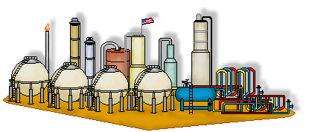
1910.119(j) Mechanical Integrity (MI)
Purpose – Equipment is maintained in a condition that is safe to operate
Applies to
Pressure vessels and storage tanks
Piping systems
Relief and vent systems and devices
Emergency shutdown systems
Controls
Pumps
Develop and implement written procedures to maintain integrity of process equipment
Training of employees involved in maintaining process equipment integrity
Overview of the process and its hazards
Procedures applicable to their job tasks

Slide 26
MI – Inspection and Testing
Procedures follow RAGAGEP
Frequency consistent with
Manufacturers’ recommendations
RAGAGEP
Documented
Date
Name of person
Identifier of equipment
Description of inspection/test performed
Results
Deficiencies must be corrected
Before further use, or
Safe and timely manner “when necessary means are taken to assure safe operation”
Nice
Right
Clean
Good

Slide 27
MI – Quality Assurance
New Plants/Equipment – Assure equipment as fabricated “is suitable for the process application for which they will be used”
Checks/inspections to assure equipment is installed
Properly
Consistent with design specifications and manufacturers’ instructions
Suitability for process application
Maintenance materials
Spare parts
Equipment

Slide 28
1910.119(k) Hot Work Permit
Purpose – Hot work is performed safely on or near a covered process
Hot work permits issued for such work
Provisions of 29 CFR 1910.252 followed

Slide 29
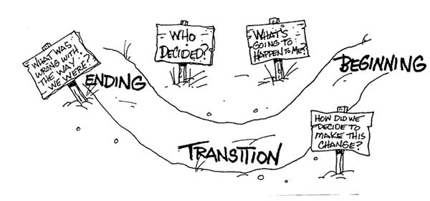
1910.119(l) Management of Change (MOC)
Purpose – Changes are reviewed and approved prior to implementation to identify and address potential hazards created by the change
Changes to
Process chemicals
Process technology
Process equipment
Procedures
Facilities that affect a covered process
Does not include replacement in kind

Slide 30
MOC - Procedure
Written MOC Procedure(s) must address
Technical basis
Impact on safety and health
Modifications to operating procedures
Time period for the change
Authorization requirements
Employees must be informed and trained in the change prior to start-up
Employees operating process in which change occurs or is impacted
Maintenance and contract employees whose job task will be affected by the change
Update elements impacted by the change
PSI
SOPs

Slide 31
1910.119(m) Incident Investigation (II)
Purpose – Investigate and learn from incident to prevent recurrence
Investigate incidents that “resulted in, or could reasonably have resulted in a catastrophic release of highly hazardous chemical in the workplace”
Begin incident investigation as soon as possible, but within 48 hours
Incident Investigation Team
One person knowledgeable in the process
Others “with appropriate knowledge and experience to thoroughly investigate and analyze the incident”
Contractor employee, if the incident involved work of the contractor

Slide 32
Incident Investigation Report
Must include
Date of incident
Date incident investigation began
Description of the incident
Factors that contributed to the incident
Recommendations
System to
Promptly address and resolve the incident report findings and recommendation
Resolutions and corrective actions documented
Report shared with all affected personnel whose job tasks are relevant to the findings, including contract employees
Retain report for five years

Slide 33
1910.119(n) Emergency Planning and Response (ER)
Purpose – Respond to incidents that occur in covered processes
In conformance with 29 CFR 1910.38
Must include handling small releases

Slide 34
1910.119(o) Compliance Audits
Purpose – Evaluate compliance with the PSM Standard
At least every 3 years
Certify compliance evaluated
Verify procedures and practices developed under the standard are adequate and being followed
Audit conducted by at least one person knowledgeable in the process
Report of findings must be developed
Document
Promptly determine and document responses to each finding
Deficiencies have been corrected
Retain at least 2 most recent audit reports

Slide 35
1910.119(p) Trade Secrets
Purpose – Recognize that information required under the standard may be trade secret, but that this is not an impediment to sharing the information with affected employees
Information related to
PSI
PHAs
SOPs
II
ER
Compliance Audits
Can require “those to whom the information is made available” to sign confidentiality agreements
Employees and designated representatives must have access to trade secret information in PHAs and other documents required to be developed under the standard

Slide 36
OSHA PSM – What’s Missing
CCPS Risk Based Process Safety
Process Safety Culture / Leadership Commitment
Process Safety Competency
Stakeholder Outreach
Conduct of Operations
Process Safety Metrics
Management Review and Continuous Improvement
Chemical Safety Board
Chemical Reactivity
Combustible Dusts
Other Stakeholders
Inherently Safer Design

Slide 37
Questions?

