Slide 1


Do we REALLY need more Process Safety Leaders?
The Criticality of Effective Followership
Jennifer F. Mize
Peter N. Lodal
Eastman Chemical Company
East Tennessee AIChE Section Meeting
September 14, 2016
Notes:
Pete Lodal presented this at the 2015 AIChE Midwest Conference in Chicago in March.

Slide 2
The Nature of Leadership
Convergent and Divergent Thinking

Slide 3
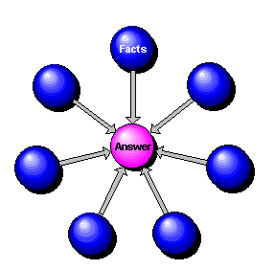
Convergent Thinking
Notes:
Convergent thinking--bringing material from a variety of sources to bear on a problem, in such a way as to produce the "correct" answer.
This kind of thinking is particularly appropriate in science, math and technology.

Slide 4
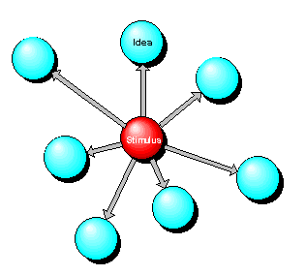
Divergent Thinking
Notes:
The other is termed "divergent" thinking. Here the student's skill is in broadly creative elaboration of ideas prompted by a stimulus, and is more suited to artistic pursuits and study in the humanities.

Slide 5

Leadership
Notes:
Leadership, like raising children, is a divergent problem.
Thus, there is rarely only one “right” answer to any given problem, unlike many science and engineering problems.
As engineers and managers, we are trained to think “convergently.”
We also tend to commingle leadership and management—they are related, but distinct skill sets.

Slide 6
Management vs. Leadership
What is the difference between management and leadership?
  Managers have subordinates.
  Leaders have followers, not subordinates.
Following is always a voluntary activity.
Notes:
What is the difference between management and leadership?
The biggest difference between managers and leaders is the way they motivate the people who work or follow them, and this sets the tone for most other aspects of what they do.
Many people, by the way, are both. They have management jobs, but they realize that you cannot buy hearts, especially to follow them down a difficult path, and so act as leaders too. Telling people what to do does not inspire them to follow you. What leaders realize is the importance of enthusing others to work towards their vision.

Slide 7
The Point to Remember
Engineering is convergent thinking.
Management is convergent thinking.
Leadership is divergent thinking.
Leadership is divergent thinking.

Slide 8
The One Thing That ALL Leaders Need…
FOLLOWERS
Notes:
So, what about followers?
The common perception is that followers are “lesser” than leaders.
In the extreme, followers are characterized as:
Sheep—blindly following, not thinking
A leader with no followers cannot be a leader.
Anarchists—subverting the goals of the group
Followership is something to be avoided if possible (it is not), or superseded—grown out of, if you will.
Popular culture goes a long way in reinforcing this idea—consider the following Audi ad, which ran for 5 years:

Slide 9


Audi Ad Campaign 2002-2007
Notes:
Introduce Kellerman’s book here

Slide 10

For Leadership:
  487,000,000 hits for “Leadership”
  68,000,000 for “Leadership Development”
  72,000,000 for “Leadership Training”
For Followership:
  421,000 hits for “Followership”
  231,000 for “Followership Development”
  156,000 for “Followership Training”
Notes:
A Google search – scientifically rigorous of course
These are ratios of 300 to 1100 to 1

Slide 11
Followers
Barbara Kellerman, in her book “Followership: How Followers are Creating Change and Changing Leaders”, states the issue very directly:
“[This] points out that, overwhelmingly, even now, we overemphasize the former [leadership] and underemphasize the latter [followership]. So long as we fixate on leaders at the expense of followers, we will perpetuate the myth that they [followers] don’t matter much.”
--Barbara Kellerman
Notes:
Kellerman, Introduction xvii

Slide 12
Do We Need Leaders?
So, does an increased emphasis on followers infer that leaders are not needed?
Let me address this question using another “close to home” baseball example:

Slide 13
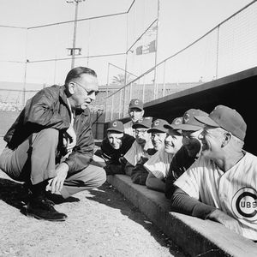
Do We Need Leaders?
December 21, 1960: P.K. Wrigley announces that the Chicago Cubs will not have a manager, opting instead for "College of Coaches.“
Basically, there was no established leader—”everyone” was in charge, on a rotating basis.

Slide 14
Do We Need Leaders?
This was a team with:
  A two-time NL MVP
    (Banks, 1958-59)
  Two Rookies of the Year
    (Williams—1961, Hubbs—1962)
  A no-hit pitcher
    (Cardwell--1960)
  And, oh yeah, a kid who was the 1959 Pan-Am games MVP
    (Brock)
Five future Hall of Famers—
  (Banks, Williams, Santo, Ashburn, Brock)

Slide 15
Do We Need Leaders?
Their records under this system:
  1961: 64-90
    7th of 8 teams, the last year before expansion, 29 games out of first.
  1962: 59-103
    9th of 10 teams, finishing behind the expansion Houston Colt 45s, 42½ games out of first
In April 1963, Philip Wrigley (mercifully) gave up on his experiment. With everyone in charge, no one was in charge.

Slide 16
Do We Need Leaders?
Pitcher Dick Ellsworth, who finished with a record of 9-20 in 1962 believed that the “College of Coaches” offered “no leadership, and that lack of leadership was reflected in how we did on the field.”
  Note: Ellsworth won 22 games for the Cubs in 1963 after the experiment was abandoned.

Slide 17
Followership
Popular culture in general tends to downplay anything but “First” or “Best”.
Consider these phrases:
  Second place
  Second rate
  Second chair
  Second fiddle
All have a strongly negative connotation in today’s culture.

Slide 18
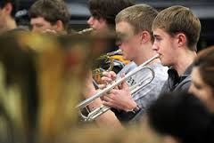
Second Chair
Notes:
For all of us who have ever played a musical instrument in a school band or orchestra, we know the battles for First Chair—the dreaded tryout!
Second chair always meant inferior musicianship—no one ever “challenged” to become second chair.
After all, if you were any good, you would be First Chair, wouldn’t you?

Slide 19
Second Chair
Second chair is where you put the kids who really couldn’t play, and whom you hoped would quit—and soon!
Sort of like right field in T-ball, to use a baseball analogy.
Let me introduce you to a friend of Pete’s…

Slide 20

John Hagstrom
Notes:
John Hagstrom has been a member of the Chicago Symphony Orchestra since 1996.
Currently in his seventeenth season as the orchestra's second trumpeter, he has held this position longer than any other player in the CSO's history.

Slide 21
Second Trumpet
Second Trumpet? Like second place, second fiddle, second rate.
This guy must not be any good —not only is he not first, he’s been second longer than anyone in CSO history! 17 years and counting.
In the words of Lee Corso, “Not so fast….”

Slide 22
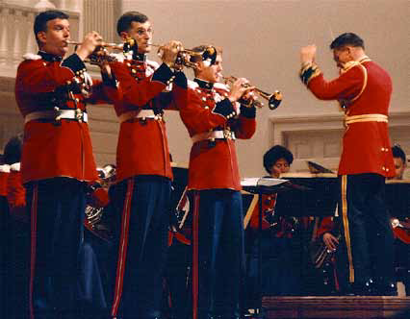
The President’s Own
Notes:
John Hagstrom (second from left) as part of a cornet trio soloing with “The President’s Own” United States Marine Band as part of their 1992 National Concert Tour.

Slide 23
Featured Soloist
Notes:
John Hagstrom as the featured soloist with “The President’s Own” United States Marine Band on March 15, 2010

Slide 24
Second Chair
“All of us [in the CSO trumpet section] are good enough to play first chair. That is not the point. Good musicianship requires more of the second chair—to match the first chair’s tone, tempo and volume to create the perfect blend of sound and harmony.
When you do so, the results can be spectacular.
When you don’t, well, not so much……..”
- John Hagstrom
Notes:
In one my conversations with John, he made the following statement, which has stuck with me:

Slide 25
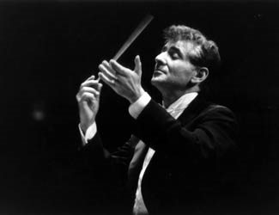
A Final Word on Second Chair
Before we leave the musical world, Leonard Bernstein, the late conductor of the New York Philharmonic Orchestra, was once asked to name the most difficult instrument to play.
Without hesitation, he replied:
“The second fiddle. I can get plenty of first violinists, but to find someone who can play the second fiddle with enthusiasm – that’s a problem; and if we have no second fiddle, we have no harmony.”

Slide 26
A Final Word on Second Chair
Without hesitation, he replied:
“The second fiddle. I can get plenty of first violinists, but to find someone who can play the second fiddle with enthusiasm – that’s a problem; and if we have no second fiddle, we have no harmony.”

Slide 27
Leadership in Process Safety
“Authentic commitment to process safety is the cornerstone of process safety excellence. Management commitment has no substitute. Organizations generally do not improve without strong leadership and solid commitment.”
  -CCPS, Risk Based Process Safety (2007)

Slide 28


Risk Based Process Safety
PROCESS SAFETY MANAGEMENT SYSTEM
Process Safety Culture
Compliance with Standards
Process Safety Competency
Workforce Involvement
Stakeholder Outreach
Process Knowledge Management
Hazard Identification and Risk Analysis
Operating Procedures
Safe Work Practices
Asset Integrity and Reliability
Contractor Management
Training and Performance Assurance
Management of Change
Operational Readiness
Conduct of Operations
Emergency Management
Incident Investigation
Measurement and Metrics
Auditing
Management Review and Continuous Improvement
COMMIT TO PROCESS SAFETY
UNDERSTAND
HAZARDS
AND RISK
Manage Risk
LEARN FROM EXPERIENCE
Copyright © 2007 Center for Chemical Process Safety of the American Institute of Chemical Engineers
Thanks to David Guss, Nexen Inc.

Slide 29
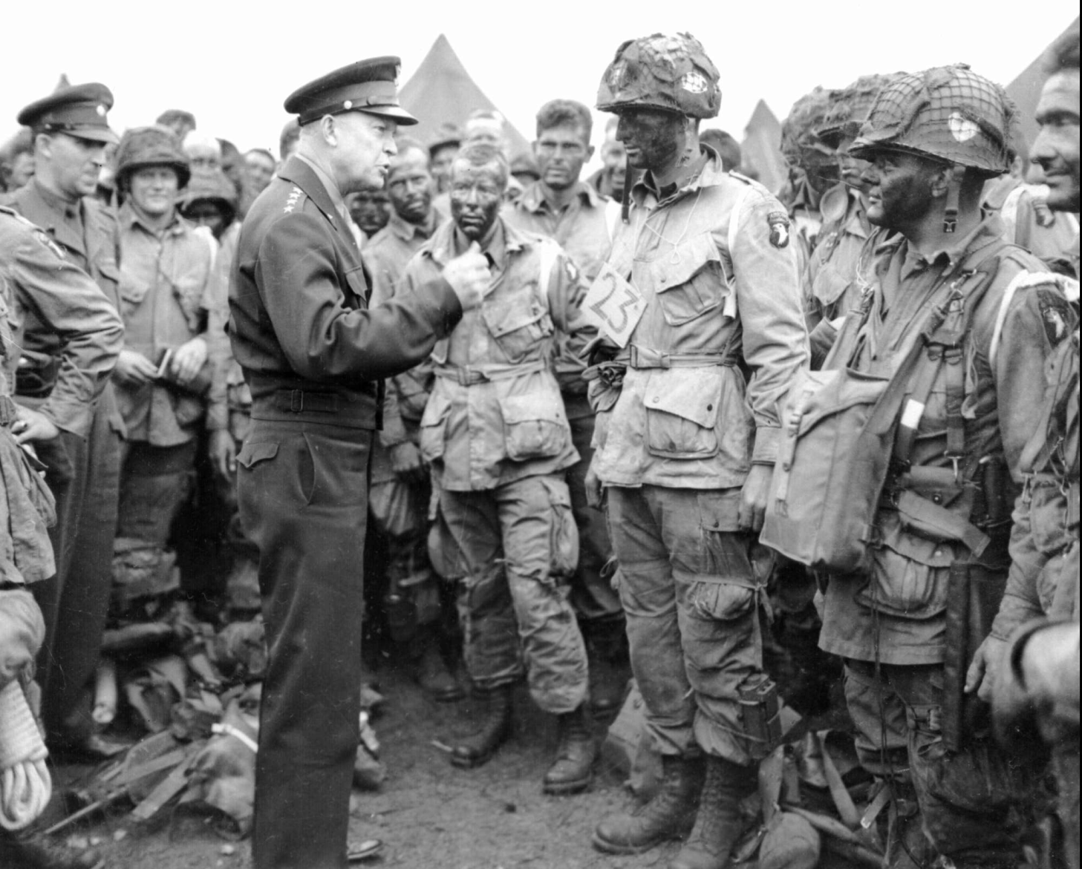
Are Strong Leaders Necessary?
Notes:
The answer to this question is “Yes, but….”
The overwhelming evidence indicates that leaders, and good leadership, are still essential to effectively carry out an organization’s function.
But in mathematical terms, they are a necessary, but not sufficient, condition for success.
Effective leaders need effective followers, and to develop effective followers, more time and attention need to be paid to them.

Slide 30

Qualities of Good Followership
1. Judgment
Notes:
John McCallum, Professor of Finance at the I.H. Asper School of Business at the University of Manitoba, has identified eight qualities of effective followers:
Judgment--Followers must take direction but they have an underlying obligation to the enterprise to do so only when the direction is ethcal and proper.
The key is having the judgment to know the difference between a directive that your leader gives on how to proceed that you do not agree with and a directive that is truly wrong.
No one disputes that good judgment is critical to being a good leader. It is just as important in the follower. Show enough good judgment as a follower and you usually end up getting a shot at being the leader.

Slide 31
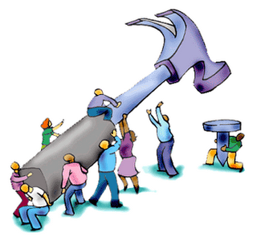
Qualities of Good Followership
2. Work Ethic
Notes:
Good followers are good workers. They are diligent, motivated, committed, pay attention to detail and make the effort. Leaders have a responsibility to create an environment that permits these qualities but regardless, it is the responsibility of the follower to be a good worker.
There is no such thing as a bad worker who is a good follower.

Slide 32
Qualities of Good Followership
    3. Competence
“For both superiors and their subordinates, the importance of competence, of expertise, changes not only the dynamic between them but also our conception of what leading and following actually entail.”
Barbara Kellerman, “Followership”
Notes:
The follower cannot follow properly unless competent at the task that is directed by the leader.
It is the obligation of the leader to assure that followers are competent.
Sometimes things go wrong because the follower is not competent at the task at hand.
When this happens, leaders should blame themselves, not the follower.
A sign of poor leadership is blaming followers for not having skills they do not have.
Kellerman, page 29

Slide 33

Qualities of Good Followership
4. Honesty
Notes:
The follower owes the leader an honest and forthright assessment of what the leader is trying to achieve and how.
Good leaders are grateful for constructive feedback from their team.
Bad leaders do not welcome feedback--followers have to tread carefully.

Slide 34
Qualities of Good Followership
5. Courage
“We know that not all followers do follow…followers who resist their leader are at risk…In the main, leaders think of followers who dispute or defy them as subversive. Typically, they pay for their transgression by being marginalized, demoted, or even dismissed.”
Barbara Kellerman, “Followership”
Notes:
Followers need to be honest with those who lead them.
They also need the courage to be honest.

Slide 35

Qualities of Good Followership
6. Discretion
Notes:
A favorite saying in World War II was “Loose lips sink ships.” Sports teams are fond of the expression “What you hear here, let it stay here.” Followers owe their enterprises and their leaders discretion. Talking about work matters inappropriately is at best unhelpful and more likely harmful.
Discretion just means keeping your mouth shut. It should be easy but many find it next to impossible. Everybody who works at an enterprise has a duty of care; indiscretion is not care, it is careless.
Bluntly, you cannot be a good follower and be indiscreet.

Slide 36
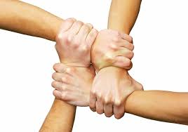
Qualities of Good Followership
7. Loyalty
Notes:
Good followers respect their obligation to be loyal to their enterprise.
Loyalty is not a synonym for lapdog.
Rather, its essence is a strong allegiance and commitment to what the organization is trying to do.

Slide 37

Qualities of Good Followership
8. Ego management
Notes:
Good followers have their egos under control. They are team players in the fullest sense of the concept. They have good interpersonal skills. Success for good followers relates to performance and goal achievement not personal recognition and self promotion.
Sounds too good to be true and often it is. It is difficult but the best organizations tie advancement and reward to performance and goal achievement as hard as that may be to do.

Slide 38
A Item to Notice
    Judgment
    Work Ethic
    Competence
    Honesty
    Courage
    Discretion
    Loyalty
    Ego Management
Notes:
Who would not benefit from giving some thought to how they could be a better follower?
And what leader or organization would not benefit from giving some thought to how they can develop better followers?

Slide 39
A Item to Notice
Here is where we catch a break:
The list for effective followership looks suspiciously like the qualities we want in an effective LEADER!
This observation infers that much of the training and methods used to develop good leaders can also be used to help develop good followers.

Slide 40
The Point to Remember (Again)
Engineering is convergent thinking.
Management is convergent thinking.
Leadership is divergent thinking.
Followership is ALSO divergent thinking!
divergent thinking.

Slide 41
Where to Start
Since this is a divergent-thinking topic, the approach for different disciplines and areas of expertise will be different.
For example:
  Identify those courses, assignments and projects which would help develop good leaders, and look at how they might be adapted to followers.
  Not everything will translate (e.g., you aren’t going to send all your employees for a company-sponsored MBA).

Slide 42
Where to Start
Using Process Safety an example, there are several specific things we use for leadership (and followership) development:
  Basic Understanding of Process Safety Concepts
  Analysis Methodologies
  Hazard Recognition
  Hazard Appreciation (Respect)

Slide 43
Other Things to Take Note Of
The leader-follower relationship is one that takes time to develop.
  Do not expect results overnight
  Beware of the “revolving door” in gaining experience
    Twenty people with one year’s experience is NOT the same as one person with twenty years’ experience
Trust is a key factor, and trust comes only with time and experience.
Notes:
At end -
Here is an example with which you are all familiar:

Slide 44
The Best Example I Know of Excellent Leadership and Followership
USAir Flight 1549
January 15, 2009

Slide 45
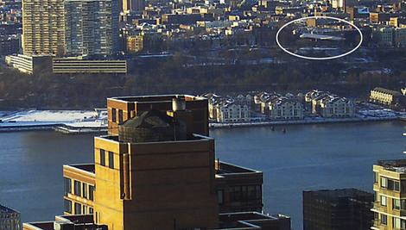
Notes:
On January 15, 2009, US Airways Flight 1549, an Airbus A320 piloted by Captain Chesley B. "Sully" Sullenberger made an unpowered emergency water landing in the Hudson River after multiple bird strikes caused both jet engines to fail.

Slide 46
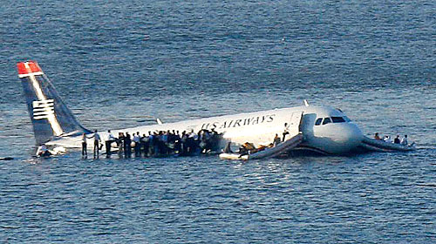

Slide 47
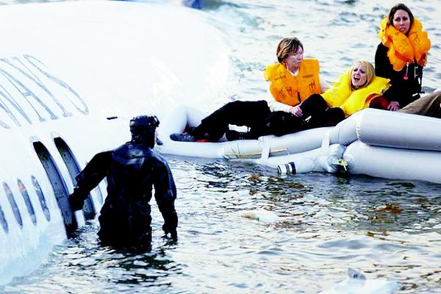
Notes:
All 155 occupants, (passengers and crew), successfully evacuated from the partially submerged airframe as it sunk into the river. All were rescued by nearby watercraft.
No life was lost including one passenger who was in a wheelchair. Only one passenger required hospitalization overnight.
Without Capt. Sullenburger successfully landing the plane on the Hudson, there would have been no opportunity for the followers to do anything. (LEADERSHIP)
However, without the discipline and training of the crew and those on shore and in the rescue boats, none of the passengers would have made it to shore safely. (FOLLOWERSHIP)

Slide 48
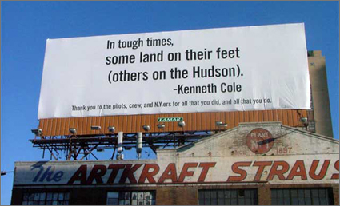
Notes:
What could so easily have ended in tragedy came to be known as the "Miracle on the Hudson“
As the Leader, Captain Sullenberger became an “instant” hero.
However, Captain Sullenberger did not evacuate all 150 passengers himself—he had help
4 other crew members
150 passengers
Numerous members of the public

Slide 49
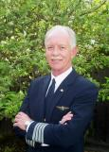
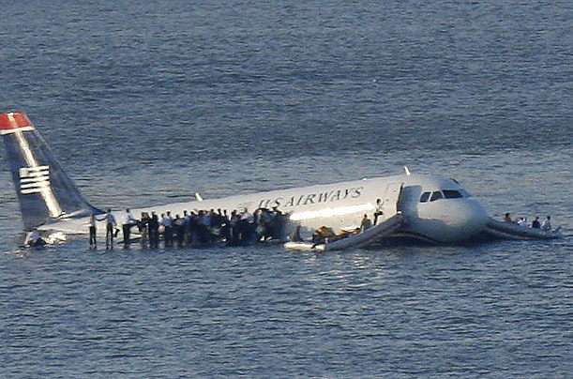
Captain Sullenberger’s View of Leadership—and Followership
“One way of looking at this might be that for 42 years, I've been making small, regular deposits in this bank of experience, education and training.
And on January 15, 2009 the balance was sufficient so that I could make a very large withdrawal."
Chesley Sullenberger
(Purdue Boilermaker!)

Slide 50
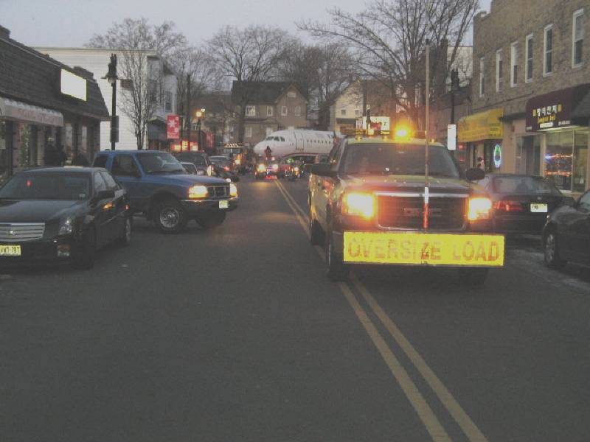

Slide 51
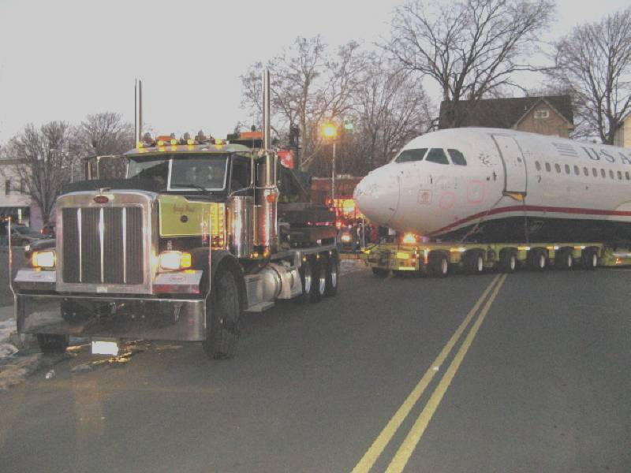

Slide 52
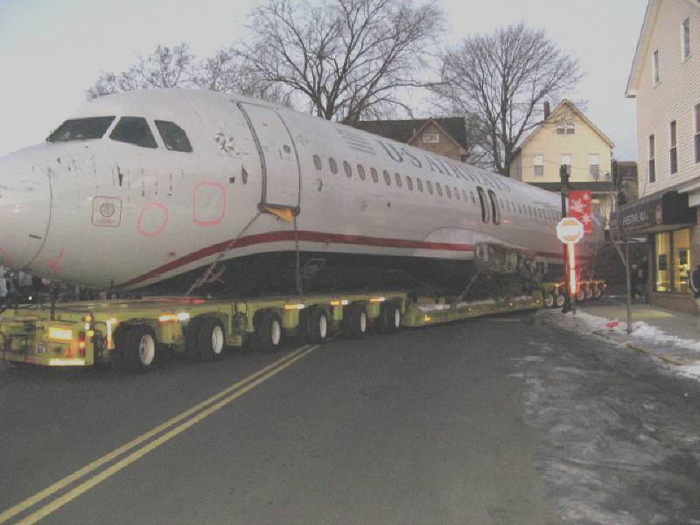

Slide 53
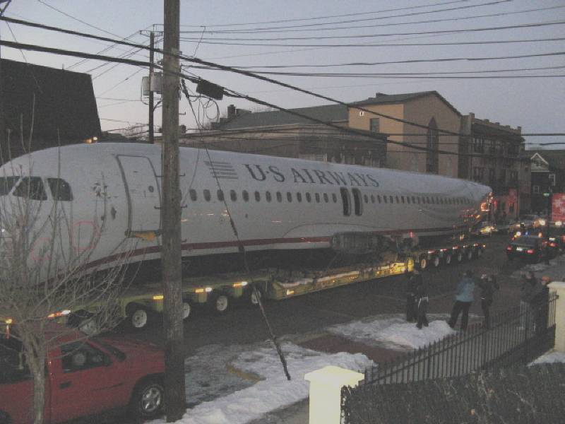

Slide 54
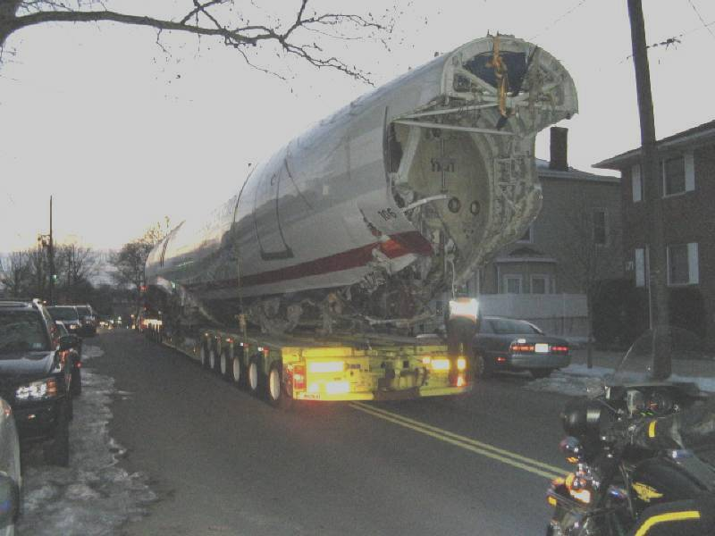

Slide 55
Risk Based Process Safety
PROCESS SAFETY MANAGEMENT SYSTEM
Process Safety Culture
Compliance with Standards
Process Safety Competency
Workforce Involvement
Stakeholder Outreach
Process Knowledge Management
Hazard Identification and Risk Analysis
Operating Procedures
Safe Work Practices
Asset Integrity and Reliability
Contractor Management
Training and Performance Assurance
Management of Change
Operational Readiness
Conduct of Operations
Emergency Management
Incident Investigation
Measurement and Metrics
Auditing
Management Review and Continuous Improvement
COMMIT TO PROCESS SAFETY
UNDERSTAND
HAZARDS
AND RISK
Manage Risk
LEARN FROM EXPERIENCE
Copyright © 2007 Center for Chemical Process Safety of the American Institute of Chemical Engineers
Thanks to David Guss, Nexen Inc.
Notes:
Let us return to the “Temple of Process Safety”, in particular, the five pillars under Commit to Process Safety

Slide 56
Effective Process Safety Demands both Leadership and Followership
“Authentic commitment to process safety is the cornerstone of process safety excellence. Management commitment has no substitute. Organizations generally do not improve without strong leadership and solid commitment.”
  “The entire organization must make the same commitment. A workforce that is convinced that the organization fully supports safety as a core value will tend to do the right things, in the right ways, at the right times, even when no one is looking.”
  This is Followership
  -CCPS, Risk Based Process Safety (2007)

Slide 57
In Summary
Do we need good Process Safety Leadership?
The answer to that question is clear: Yes, we do.

Slide 58
In Summary
But at the same time, if we emphasize leadership at the expense of followership, we deprive leaders of the asset they need most—competent, dedicated followers.
You cannot have one without the other.
“A leader without followers is simply a man out taking a walk.”
-John Boehner

Slide 59
Thank You For Your Time and Attention!

