Slide 1
CORPORATE SPONORSHIP AND YOUR AICHE CHAPTER
Jacob Clendenon - Internal vice president
Fritz Hyde - Treasurer
Devesh shah – mentorship co-chair
University of Michigan aiche chapter
October 28th, 2017
Notes:
Devesh

Slide 2
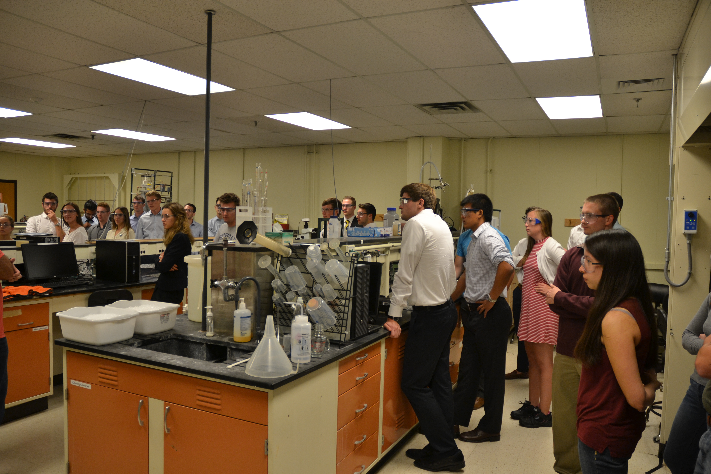
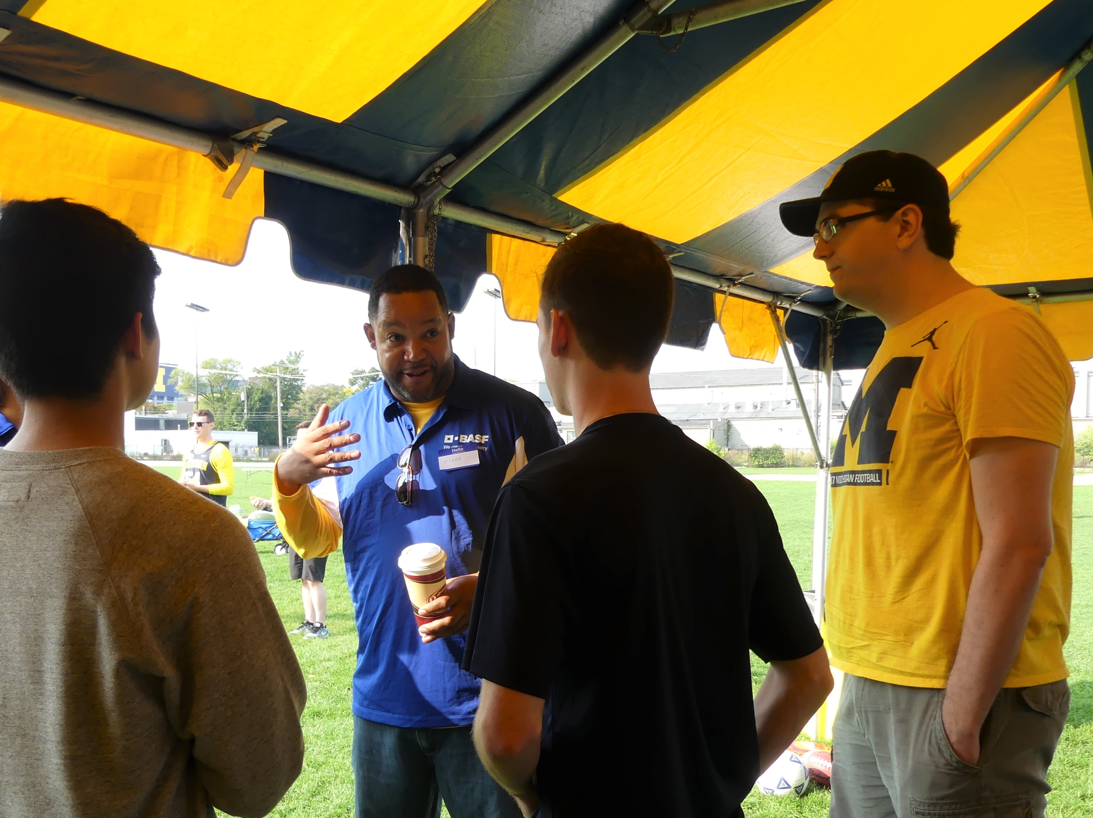
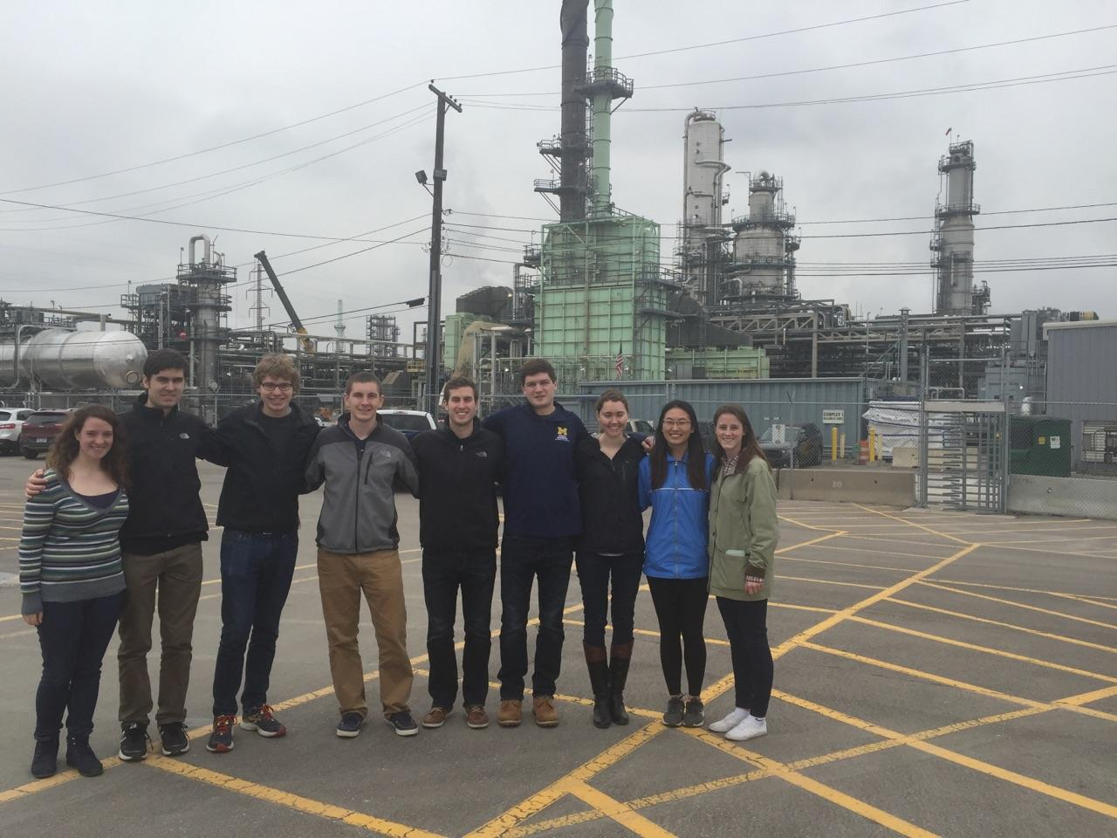
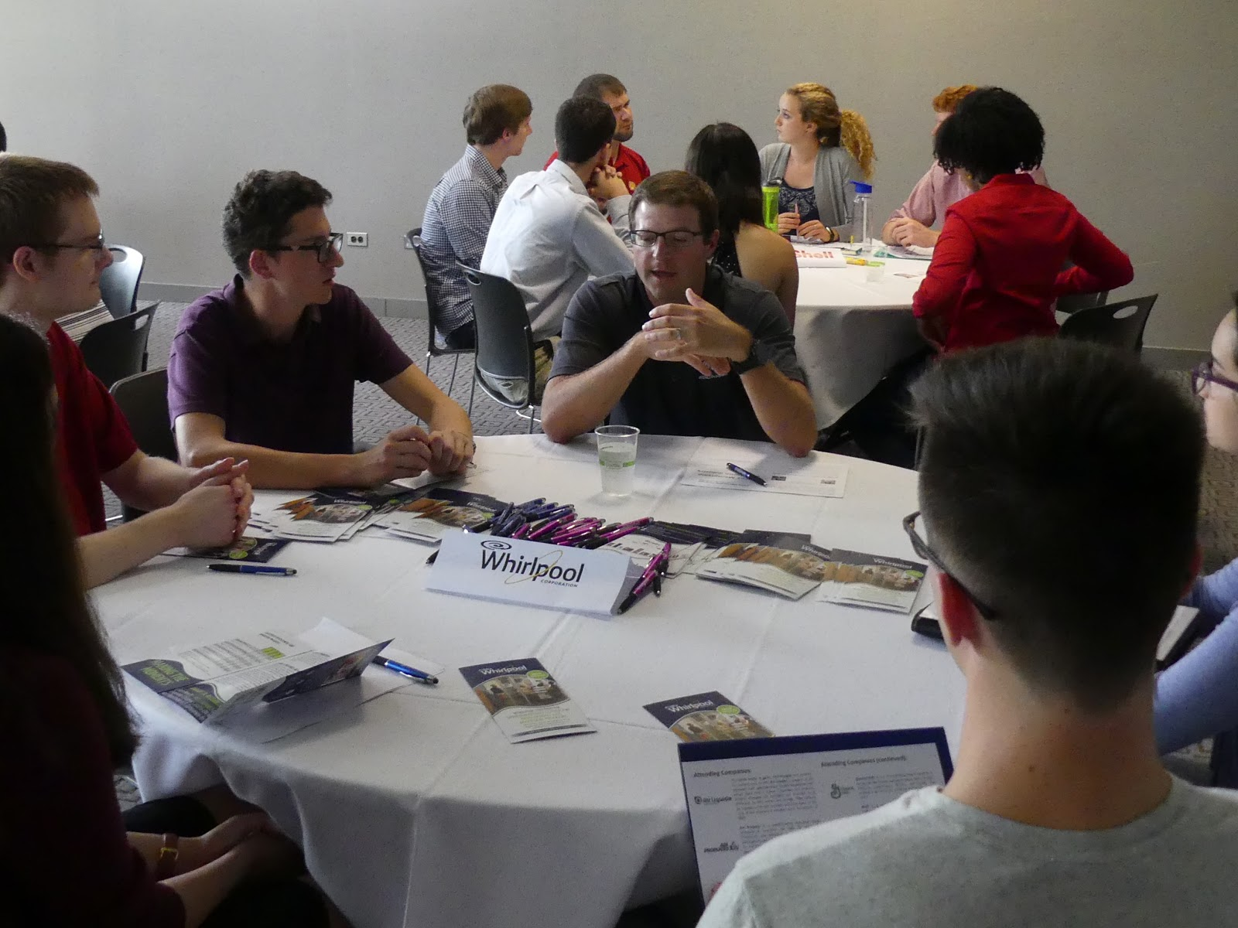
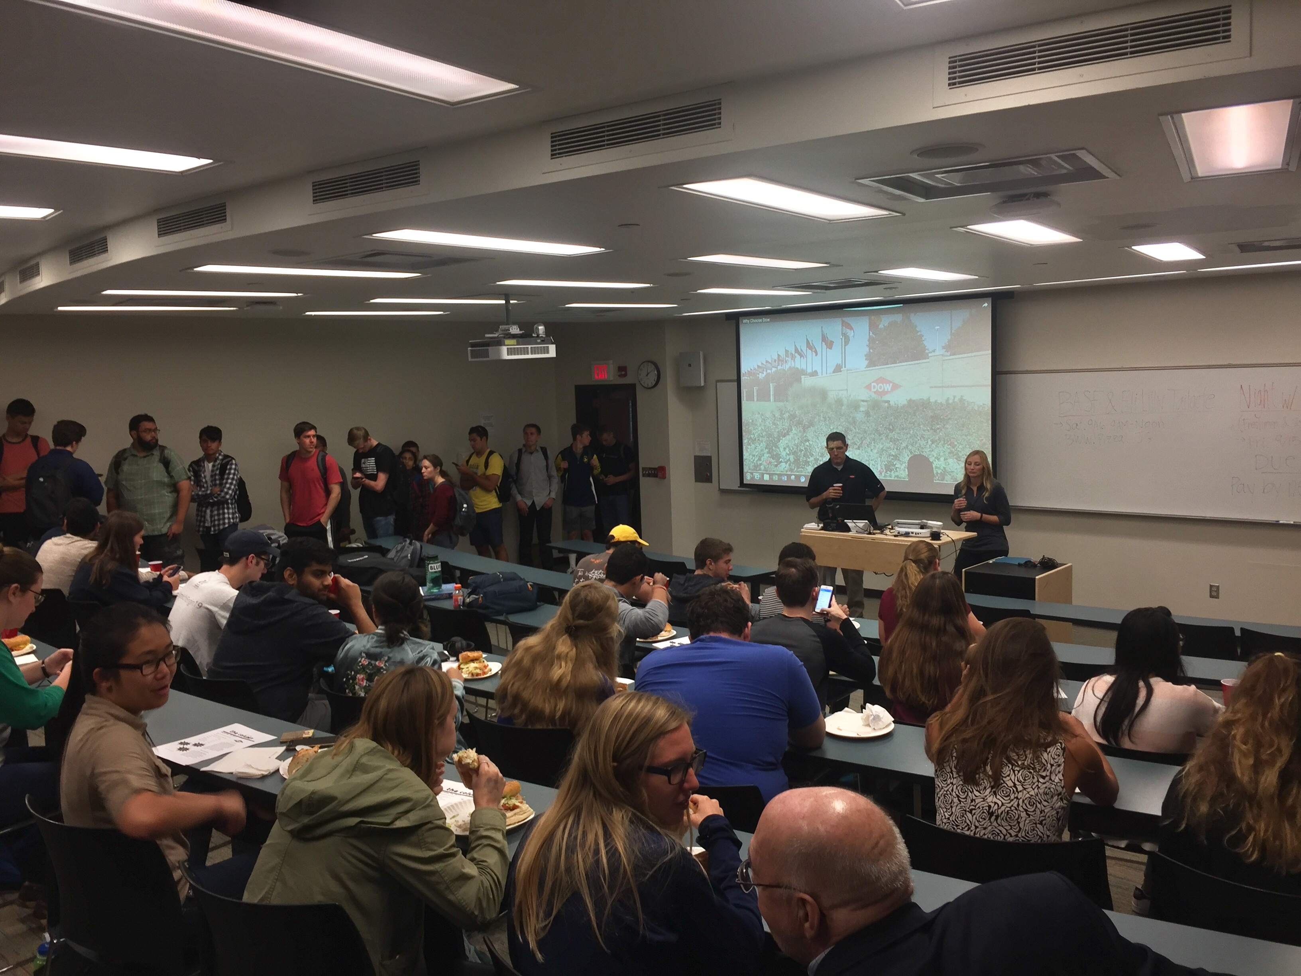
What is corporate sponsorship?
Companies committing resources to aid student chapters
Notes:
Devesh

Slide 3
Outline of today’s presentation
Making initial contact with companies
Who reaches out
Where to reach out
Why you deserve funding
How to sustain these corporate relationships
Detailed examples of our two main corporate sponsored events
Weekly luncheons
Night with Industry
How corporate sponsorship is used in our mentorship program
Notes:
Devesh

Slide 4
Who reaches out
Depends on the type of outreach
For ongoing primary events - President
For funding applications - Treasurer
Try to encourage people to join executive board by showing different positions can be in charge of different corporate outreach

Slide 5
Where to reach out
Some questions to ask of your chapter to find the right companies to reach out to:
What companies hire a lot of chemical engineers from our school?
Are they any local companies with ties to your chapter/school?
Where are recent alumni working at with strong ties to the chapter?
Does the company have any outside representation that is closer to campus?

Slide 6
Justification for why you deserve resources
First and foremost, companies set this money aside and it is there for the taking
These companies have complex processes in their plants and will always need the best and brightest chemical engineers.
This helps students in your chapter figure out if they want to work for these places and ultimately save these companies money
Companies are looking to sponsor student organizations that have an established objective

Slide 7
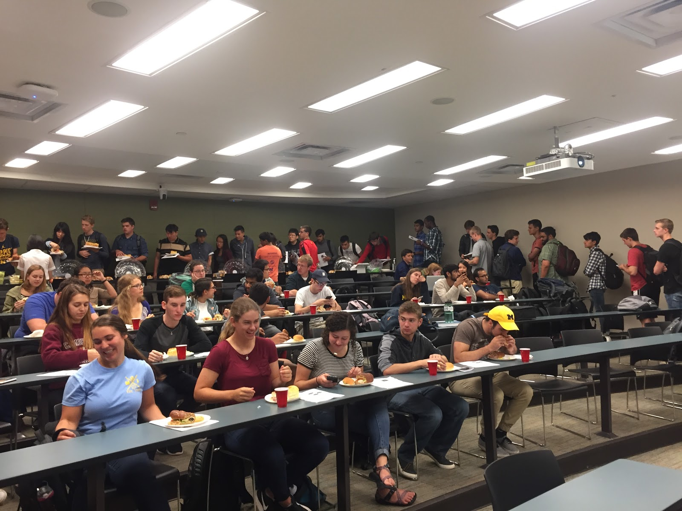
Luncheons
What are they?
Who attends?
How are they organized?

Slide 8
What are Luncheons?
Catered presentation from any company with ChE ties
Procter & Gamble, Kraft Heinz, Ford
Not unlike info sessions
Open to only AIChE dues paying members
Regularly scheduled
Every Thursday, 12-1 PM. 1200 EECS

Slide 9
Who attends luncheons?
Company Representative
Arrive on campus ~10 minutes before the luncheon starts
AIChE Members
Students line up outside of the meeting room
AIChE Executive Board
Set up the food
Facilitate smooth process
Faculty
AIChE Advisor, department advisor, & other professors attend

Slide 10
How are luncheons organized
President reserves classroom for luncheon three to four months in advance
President reaches out three to four months in advance
Generally with set of dates available
Every Thursday in the semester

Slide 11
How Are Luncheons Organized? (cont)
Coordination of date generally include email chains with companies
Educate on how to interact professionally over email
Reminder email one - two weeks in advance
Details logistics, expectations, other information
Begin planning catering
Open avenue for questions from company

Slide 12
How Are Luncheons Organized? (cont)
Catering Planning
Companies usually fund/sponsor catering for their luncheon
AIChE member orders food and company calls restaurant to pay
Currently give budget ranging $200-$600
Learn to ask for more money as politely as possible
Use evidence
VARY YOUR CATERING
Attendance will suffer without food variety
Order food at least 48 hours in advance of the luncheon

Slide 13
How Are Luncheons Organized? (cont)
Day of Luncheon - Executive Board
President meets with company representative(s)
Other members (IVP) take care of food and drinks
Secretary signs people in
Card Scanner and Excel
Treasurer takes dues
Newsletter Chair prints newsletter
Rest of E-Board monitors food and pours drinks

Slide 14
How Are Luncheons Organized? (cont)
Day of Luncheon - General Members
Wait outside the room until secretary and IVP are ready
File into room & sign in with secretary
Get food, drink, & newsletter
Sit and eat/wait for presentation to begin
Day of Luncheon – Company Representatives
Arrive 10-15 minutes before
Present and answer questions
Generally open to staying later to speak individually
Sometimes include a live demonstration relevant to a company process

Slide 15
How Are Luncheons Organized? (cont)
Day of Luncheon - Afterwards
Sustainability Committee
Committed to reducing luncheons to zero-waste
Composting sustainable materials
President requests mailing address from presenter(s)
Thank you notes
Ensure presenters get a receipt for catering

Slide 16
AIChE Mentorship Program
Hosts social and informational events for underclassmen
Connect upperclassmen ChE with incoming engineers in the program
Corporate involvement:
Plant Tours
Dow MMAIChE Mentorship Program
Connect students with engineers in the field in one-on-one environments

Slide 17
Night With Industry: What is it?
Recruiting event for only freshman and sophomores in ChE
Allow for relaxed setting for recruiters to talk with students
Small round table discussions with wide range of discussion topics
How to begin a conversation with a recruiter
What industry is like for a ChE graduate

Slide 18
Night With Industry: Event Logistics
Held the week leading up to Michigan’s annual fall career fair
Give each company its own table (typically 2-3 recruiters per company show up)
Have students rotate between each table at set time period
Hosted 9 companies this year
12 minutes per table then rotate students to next table

Slide 19
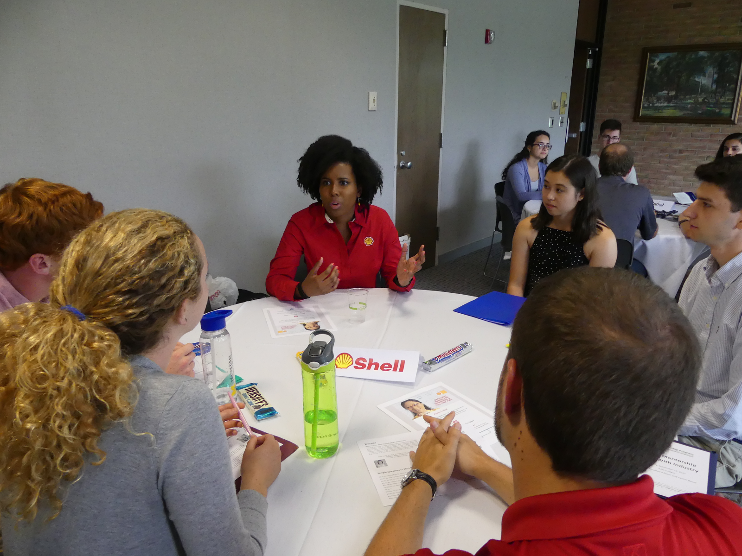
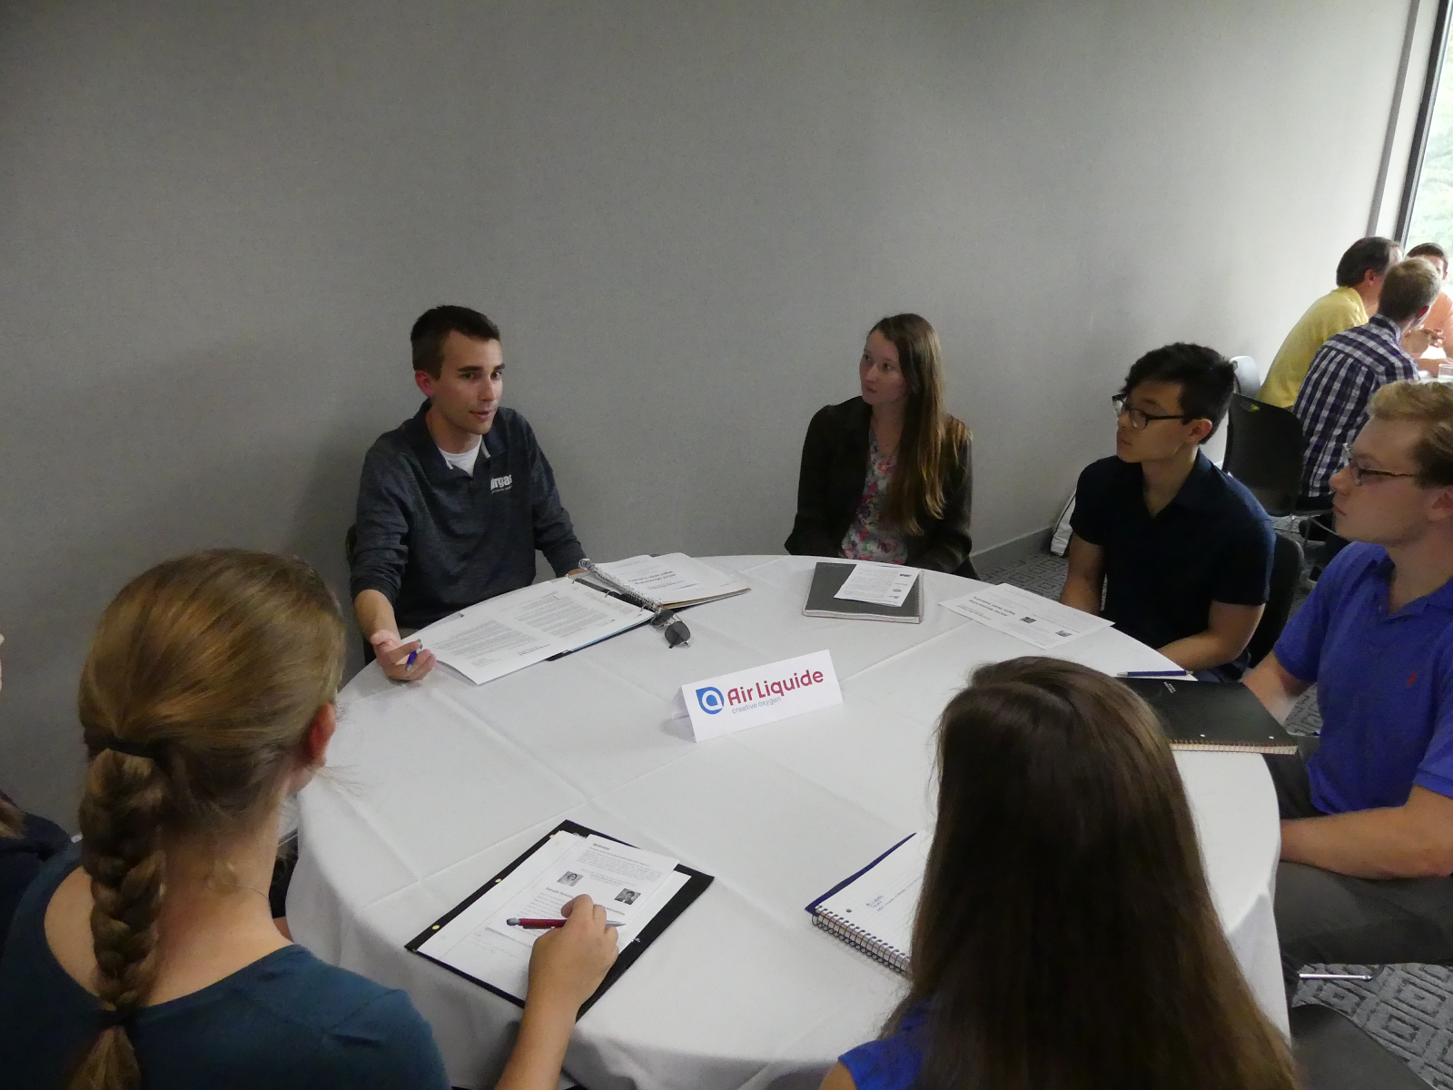
Night With Industry: Event Logistics

Slide 20
Night With Industry: Event Logistics
Resumes are optional
Business casual attire
Cater small portions of food (cookies and coffee)

Slide 21
Night With Industry: attracting companies
Many companies are already on campus recruiting because of career fair the following week
Take advantage of the fact that they are on campus.
They are there to recruit. Setting up an event like this is beneficial to both you and them
Send out invitation letters to companies about 2-3 months prior to the event
This event allows them to find young, bright students without comparing them to more qualified juniors at career fair

Slide 22
Night With Industry: attracting Students
Students will not be competing with juniors and seniors here
They don’t need to know anything about the company or how to start a conversation - that’s what this event is for!
Advertise the event in the sophomore ChE classes
Much easier to get sophomores out to this event
Get students to RSVP so you know how many chairs you’ll need

Slide 23
questions
?

