Slide 1
Welcome to the
2014 ASC Workshop on
CORPORATE SPONSORSHIP
Presented By
Georgia Tech | University of Cincinnati | Penn State | Virginia Tech

Slide 2
INTRODUCTIONS
Georgia Tech
Taylor Newsom, President
Ben Murray, Vice President
University of Cincinnati
John Panning, Co-President
Blake Boswell, Co-President
Penn State University
Andrew Osheka, President
Cory Thomas, Vice President
Virginia Tech
Shashwat Sinha, President

Slide 3
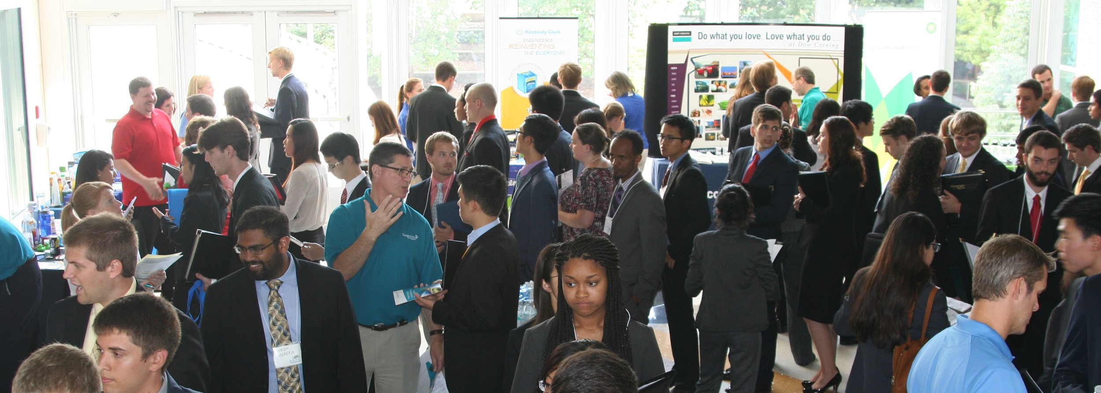
GEORGIA TECH
500+ students
$30,000 in donations for Fall 2014
Over 35 corporate sponsors

Slide 4
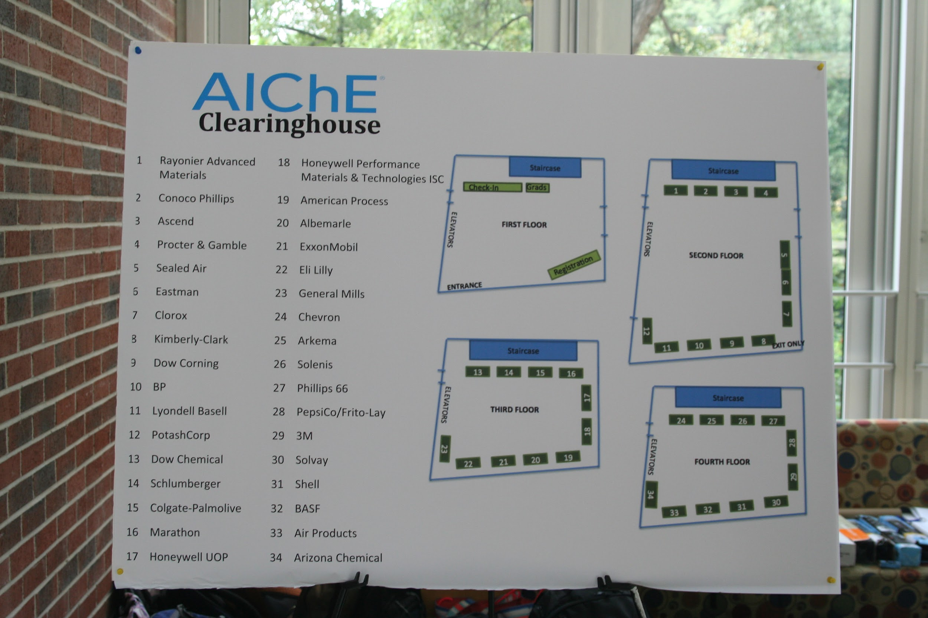
VALUE PROPOSITION
To package our sponsorships up as the best recruitment tool to effectively reach ChE students through formal and informal interactions.
Weekly L&L
16 Company Info Sessions
Clearinghouse
Maxed out at 34 booths
500+ student attendees
Resume booklet
Networking Events

Slide 5
BUILDING RELATIONSHIPS
With our expanding ChBE program and AIChE chapter, it is important to constantly build and strengthen our corporate relationshipships.
New Sponsors
Graduated Students
Networking
Strengthening Relationships
Effective officer transitions
Follow ups
Addressing and filling company needs

Slide 6
UNIVERSITY OF CINCINNATI
How To Introduce
A Corporate Sponsorship Packet
John Panning | Blake Boswell

Slide 7
FORM A FUNDRAISING COMMITTEE
Minimum of 3-5 members to accomplish group’s goals
Usually led by a fundraising chair
Chair can report to group’s treasurer
Assign specific tasks to members of the committee

Slide 8
COMPOSE A SPONSORSHIP PACKET
The packet should showcase what your chapter does.
The packet should tell why a company would like to sponsor you.

Slide 9
SPONSORSHIP PACKET CONSTRUCTION
Explain what your chapter does.
Regular meetings
Special events
Annual Regional/Student Conferences
Community outreach
Other things that make your chapter special

Slide 10
SPONSORSHIP PACKET CONSTRUCTION
Explain why a company
would like to sponsor your chapter.
Publicity perks such as a name on chapter t-shirt
Special events invitations (e.g. Industry Mixer)
Opportunity to host meetings or plant tours

Slide 11
SPONSORSHIP PACKET CONSTRUCTION
Include multiple ways a company can sponsor your chapter
Create Sponsorship Level Packages that have increasing perks (Silver, Gold, Platinum, etc.)
Offer opportunities to sponsor special events
Provide contact information for any questions a company’s representative may have

Slide 12
GAINING CORPORATE CONTACTS
Work with your university.
Most have a Career Development office with access to companies that hire students from your school
Some schools have co-op or intern advisors
Work with companies your chapter members intern for.
Have members provide an HR contact for the company they co-op or intern for

Slide 13
GAINING CORPORATE CONTACTS
Talk with professors
Professors often conduct research for industry
Keep a directory of AIChE alumni
Phone numbers, emails, names of companies
Utilize YPC and local or nearby AIChE chapters (if available)
Consider family or friends’ families

Slide 14
CONTACTING COMPANIES
Always be professional
Provide a letter explaining what your fundraising packet entails
Be sure to follow-up with both email and phone calls

Slide 15
PENN STATE UNIVERSITY
Corporate Sponsorship Opportunities
Andrew Osheka | Cory Thomas

Slide 16
SPONSORSHIP CATEGORIES
Formal Events
Information Sessions | Resume Reviews .
Seminars | Workshops
Informal Events
Tailgates | Lunch & Learns | Social / teambuilding events
Branding Opportunities
Apparel | Large Purchases

Slide 17
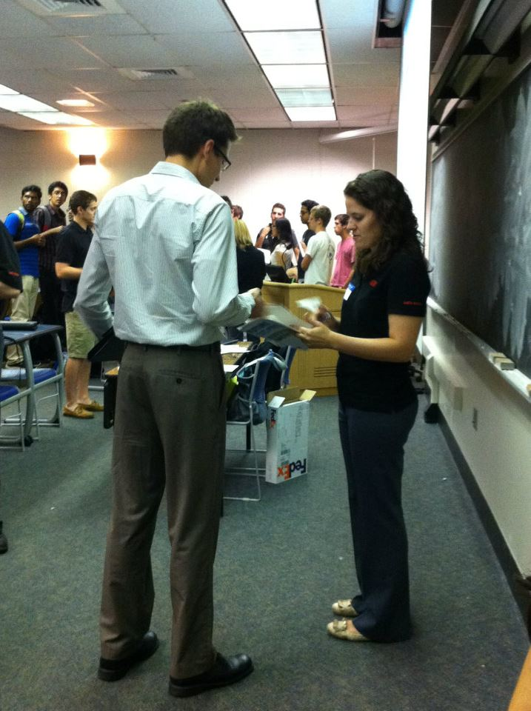
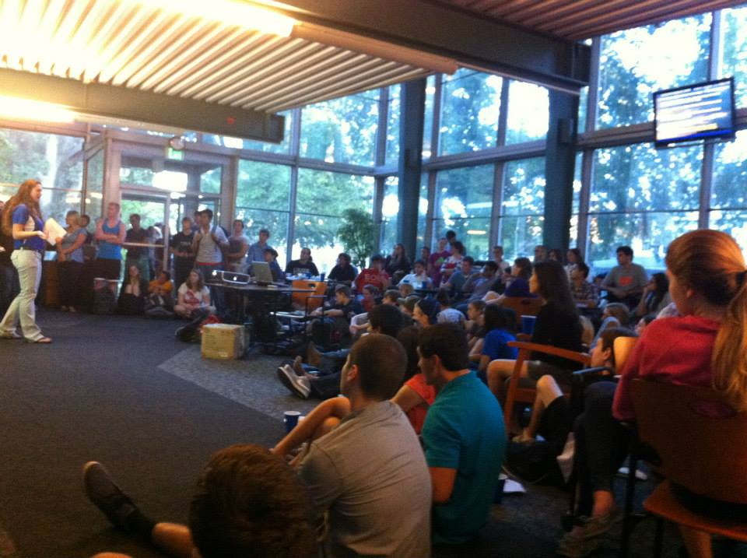
FORMAL EVENTS
General Meetings
Information Sessions
Lunch & Learns
Seminars
Resume Reviews

Slide 18
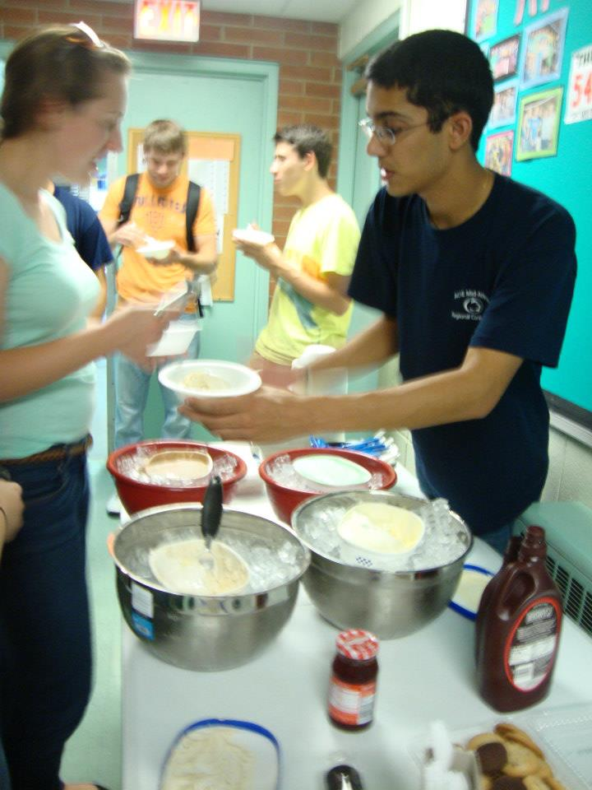
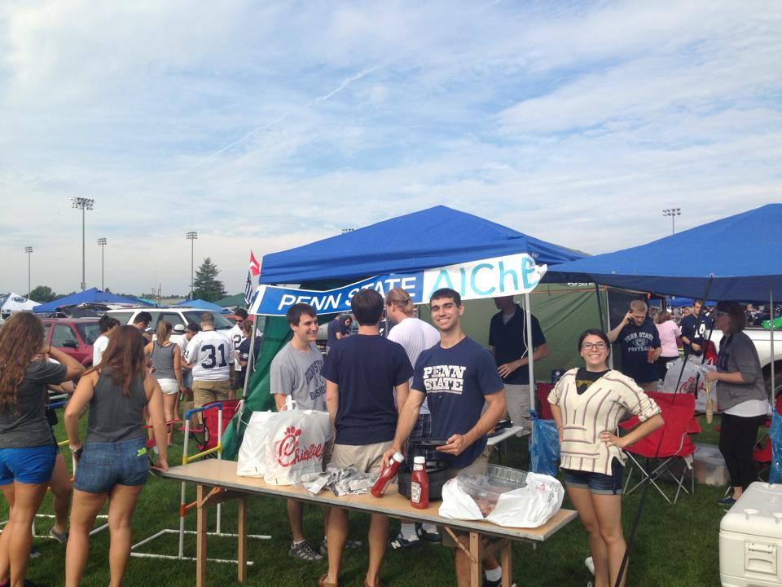
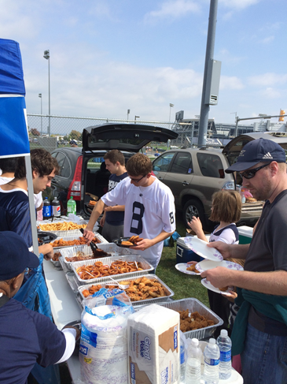
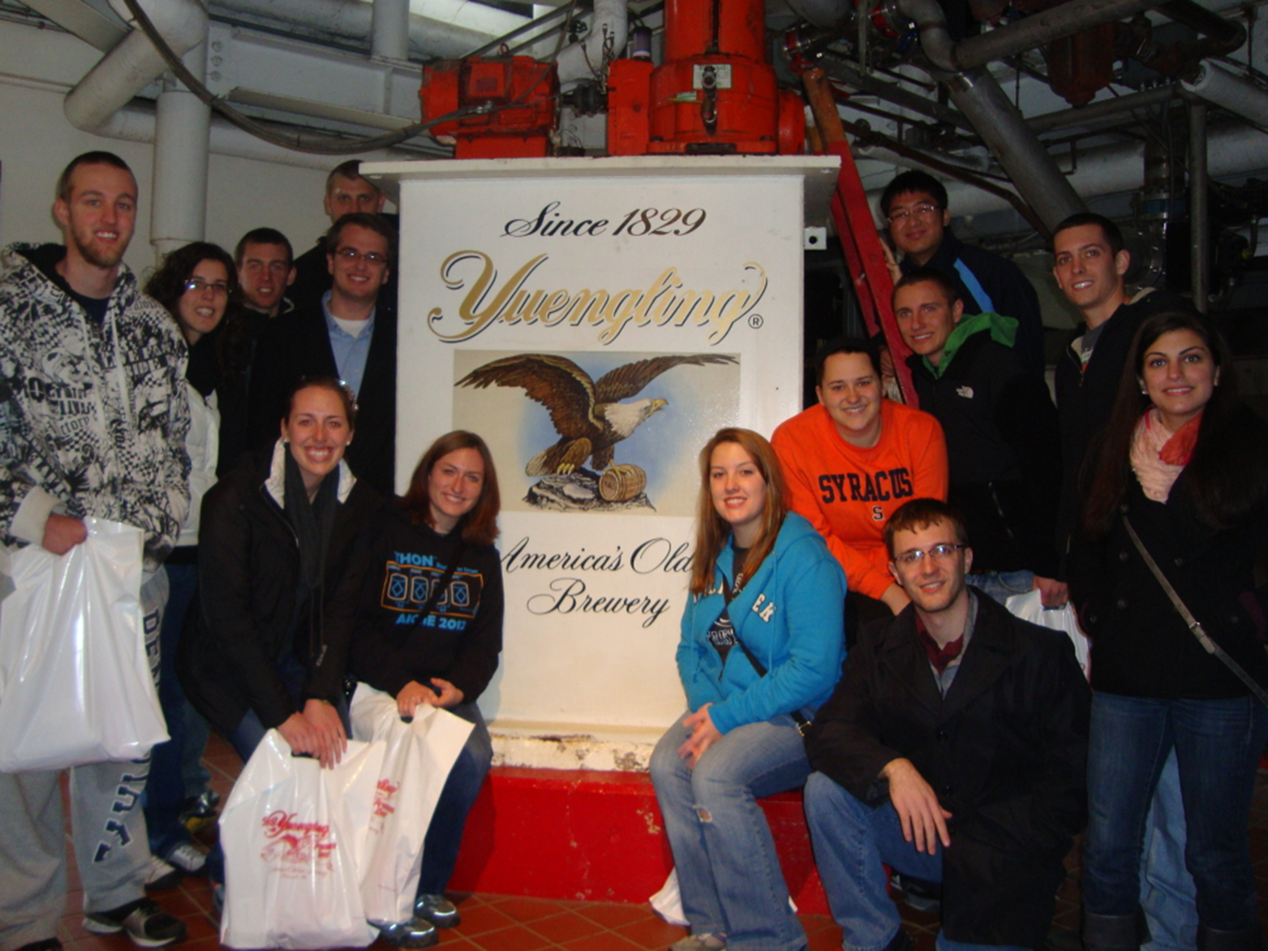
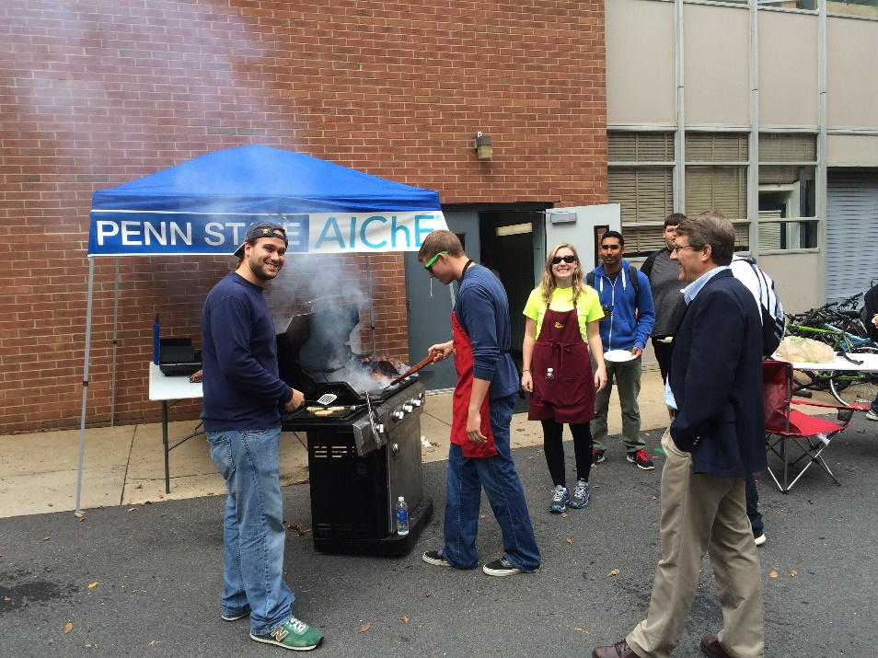
INFORMAL EVENTS
Tailgates
Ice Cream Socials
Plant Tours
Sporting / Team Building Events

Slide 19
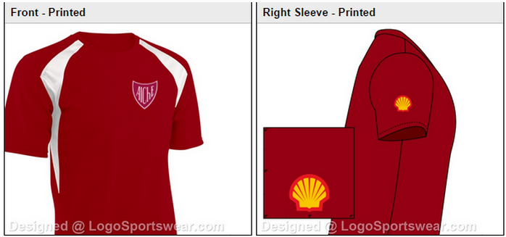
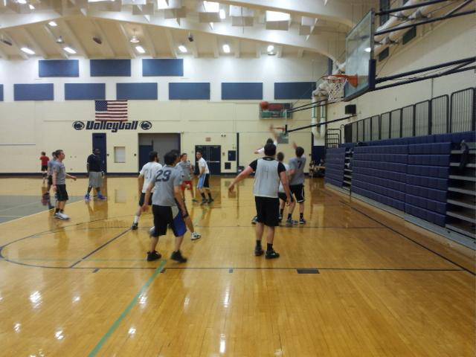
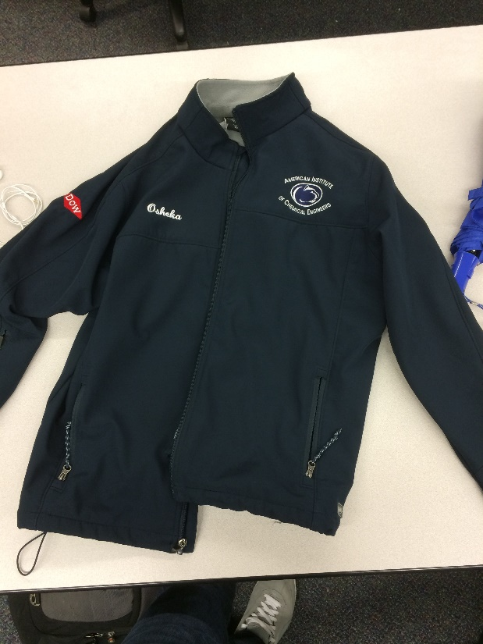
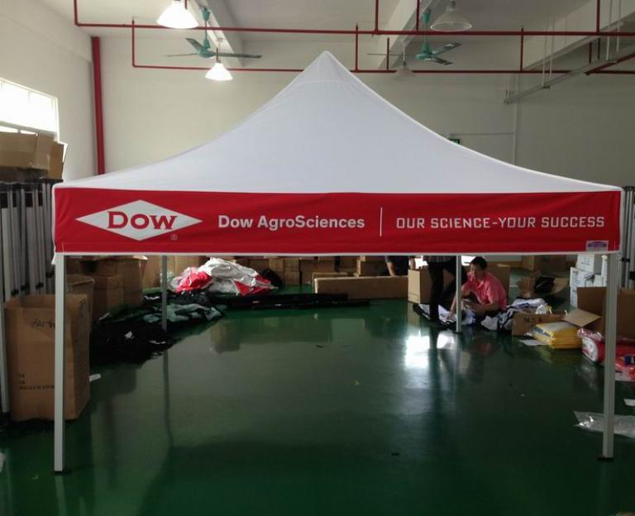
BRANDING OPPORTUNITIES
Apparel
High-visibility items
Large or
expensive events

Slide 20
KEYS TO SUCCESS
Look for opportunities that provide value to members and companies
Partnering with other student organizations (ASME, ACS, ΩΧΕ)
It never hurts to ask!
Communication is critical
Follow up

Slide 21
VIRGINIA TECH
Let’s Put It All Together!
Shashwat Sinha

Slide 22
SUMMARY
Show value to companies
Large events, Strong relationships
Create sponsorship packet
Define your chapter and opportunities to companies
Corporate Sponsorship Opportunities
Formal & Informal Events, Branding Opportunities

Slide 23
CAREER FORUM
What is it?
A night of presentations by companies
Why does it work?
Great amount of value for both companies and students
This Year
14 companies, 130+ students, $10500 raised

Slide 24
PLANNING THE FORUM
Decide date/time and type of Career Forum
Food vs. no food, presentations vs. no presentations
Have a set budget
Knowing how much money you have will decide what you can do.
Be organized
It is easy to get scattered and lost.

Slide 25
ORGANIZATION IS KEY

Slide 26
PLANNING THE FORUM
Contact companies
Email company representatives
Create donation tier system
Recognize companies based on donation levels
Send invoices for donations
Companies need invoices for donations

Slide 27
TIER LEVELS

Slide 28
WORKSHOPS
Invite companies to lead
Creates even more value for companies
Elevator speech, Resumes, Networking
Ideas for Workshops
Creates student interest for event
Advertises the Career Forum

Slide 29
AT THE FORUM
Give your officers jobs
Company representative check-in, projector setup, general help
Student Check-In
Hand out schedules and name tags
Take photos and videos
Great promotional tools for your chapter

Slide 30
AFTER THE FORUM
Send thank you emails
Be thankful to companies and invite them back for meetings
Ask companies how to improve
Strengthens relationships to incorporate company suggestions
Have a team meeting
Talk over what worked well and what can be improved

Slide 31
QUESTIONS?
Contact Information
Georgia Tech Taylor Newsom taynew02@gmail.com
University of Cincinnati John Panning panninjt@mail.uc.edu
Penn State Andrew Osheka president@psuaiche.com
Virginia Tech Shashwat Sinha shashwat@vt.edu
|
|
|
|
-
-
-
-

