Slide 1


Leadership Without Borders

Slide 2

Outline
What’s it to be a leader?
3G’s.
Going Global.
ESC global leadership Experience.
Activity.

Slide 3


What’s it to be a leader?
Notes:
1- leadership is not a technique that works with a quick recipe or tools. Leadership is an act, not a function.
2- Leadership is not owned by those in power.

Slide 4

Notes:
1- Leaders are not just the CEOs or presidents of countries and companies. They are not necessarily the ones on the top of the pyramid, not anymore.

Slide 5
3G’s
Genuine
Generous
Generative

Slide 6


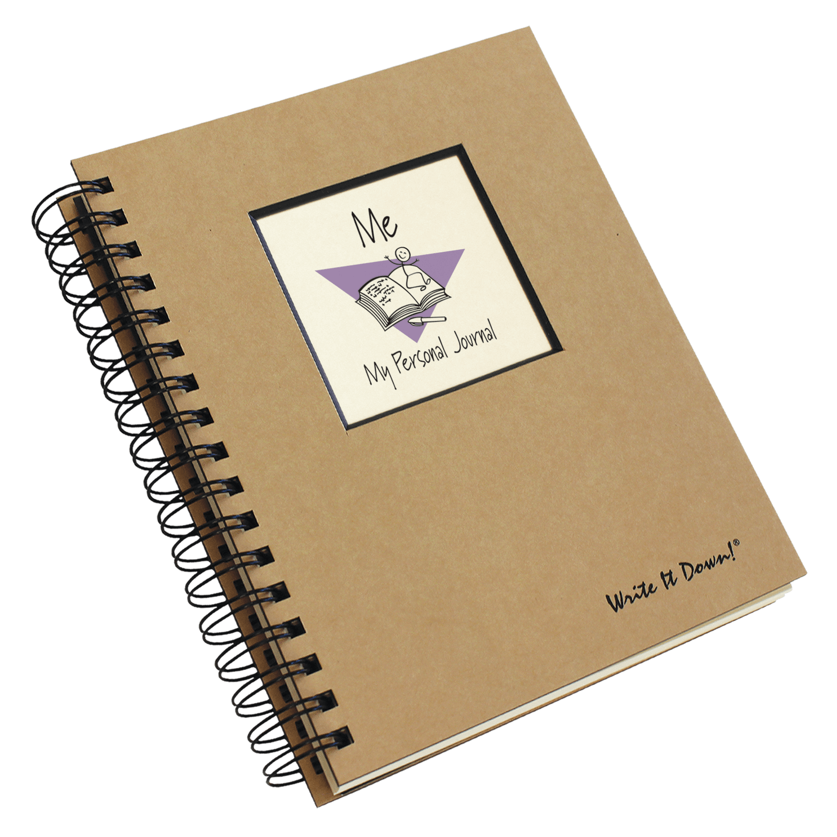

genuine
Notes:
1- Write down your goals, plans, and priorities.
2- Keep a journal.
3-Ask for feedback.
4- Take personality and psychometric tests

Slide 7
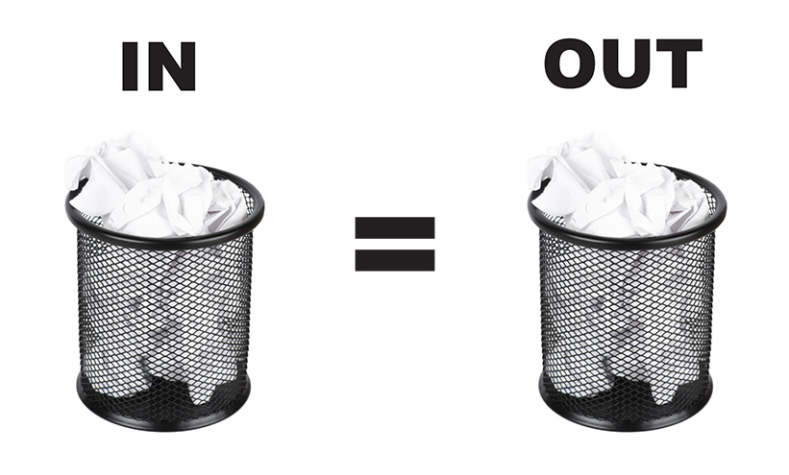

generous
Notes:
1- Generosity, means moving from confidence to trust. Trust develops from the way you behave with your colleagues and employees or friends. It is particularly important in difficult times when you need to stand strong in the face of adversity.
IT”S NOT A QUESTION OF QUNATITIY IT”S A QUESTION OF QUALITY.

Slide 8

generative

Slide 9
ESC global leadership Experience
1. Global Leadership.
2. ESC Contribution.
3. Skills to demonstrate.
Notes:
** Going Global and more challenges (Different Mindsets), but it has a great impact on your personality.
1- Andrea.
2- Ayush.

Slide 10
Activity
Project 1 | Project 2 | Project 3
A | 1 | I
Project 1 | Project 2 | Project 3
A | 1 | I
B | 2 | II
C | 3 | III
D | 4 | IV
E | 5 | V
F | 6 | VI
Notes:
1- What you do is you pay the price for multitasking in what we call switching cost.
2- So what is Switching Cost? It is the time it takes for you to transition from one thing to another, and
then to another, and then back again.
Then I come back 15 minutes later. I say, no, sorry, work on task B. An hour later I call you and I say, 5what are you doing? Would you please work on task C? And at the end of the day I come back to you. And I say, well did you ever finish task A? No? Well get on it.
Every time you go in and out of task A, you need time to reacquaint yourself with the task. Time to remember where you were, what you were doing, and what you need to do next. So this is your switching cost. And it means that although task A could take two hours, it may take you up to three if I keep pulling you in and out of it. And putting you back to work on it, and doing something else, and back and forth.

Slide 11

Challenge your colleagues and climb the leaderboard with the all new AIChE Scavenger Hunt!
Login to www.aiche.org/ScavengerHuntASC.
Find and enter the code for each activity to earn points.
This session’s code is: SCWorkshop

Slide 12


