Slide 1


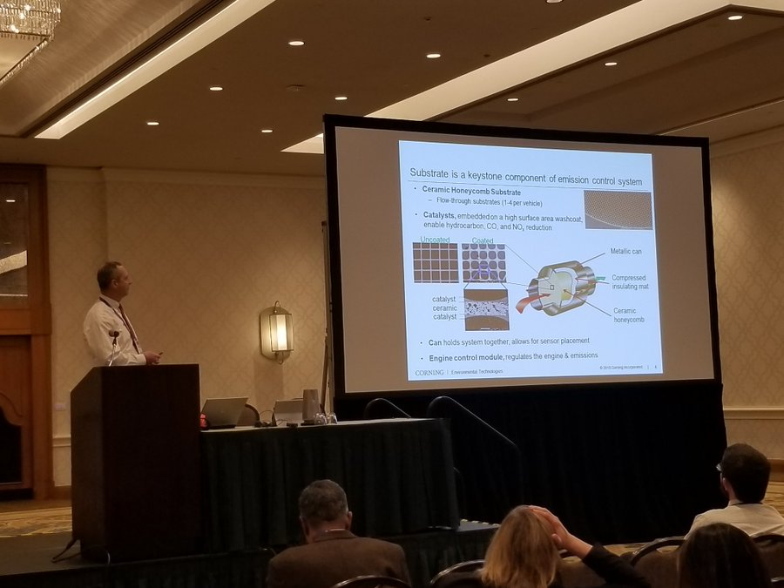
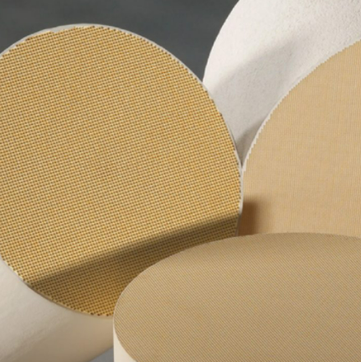


Historical Perspective of the Development of the Ceramic Honeycomb Catalytic Convertor Substrate
Honeycomb Catalytic Convertor Substrate: Keeping the Air Clean Since 1974 Doug Beall
What: Talk by Corning Development Fellow Doug Beall
When: June 15, 2022 @ 12:00 PM
Where: WebEx – contact smithbh@corning.com
https://www.aiche.org/community/sites/local-sections/twin-tiers/events
Join us to learn about how Corning risked it all in the race to develop new emission control technology. Open to the public, please share!
Twin Tiers Local Chapter
AIChE

