Slide 1
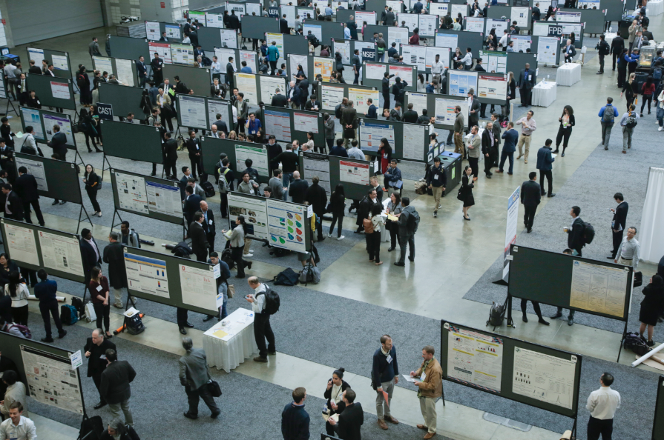
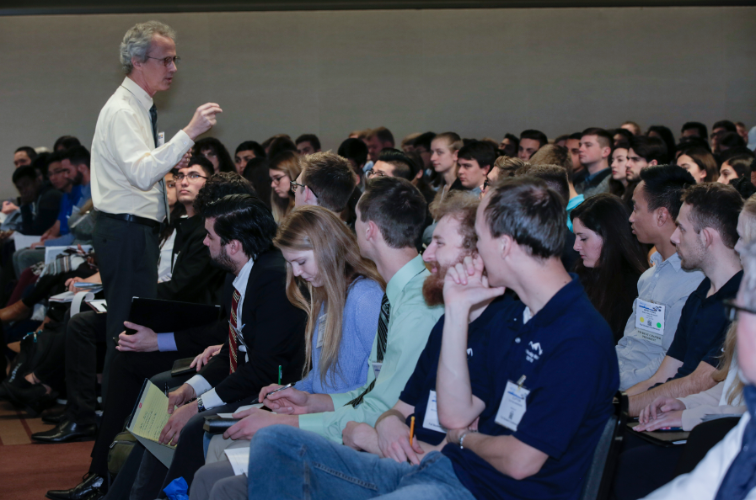
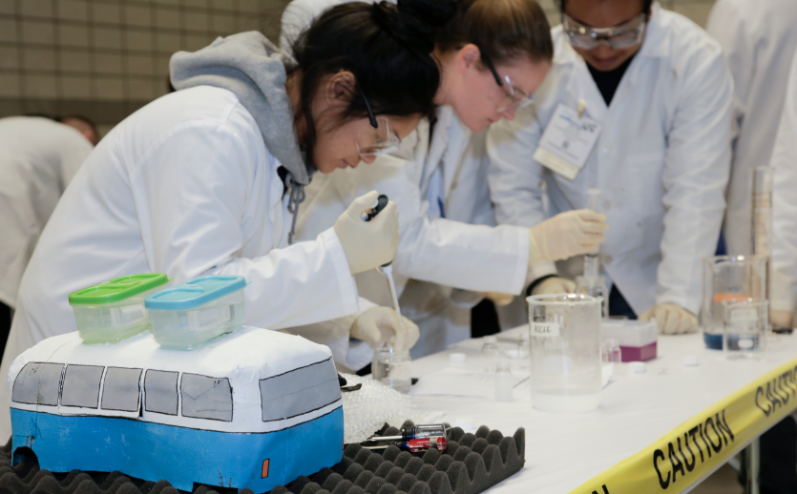
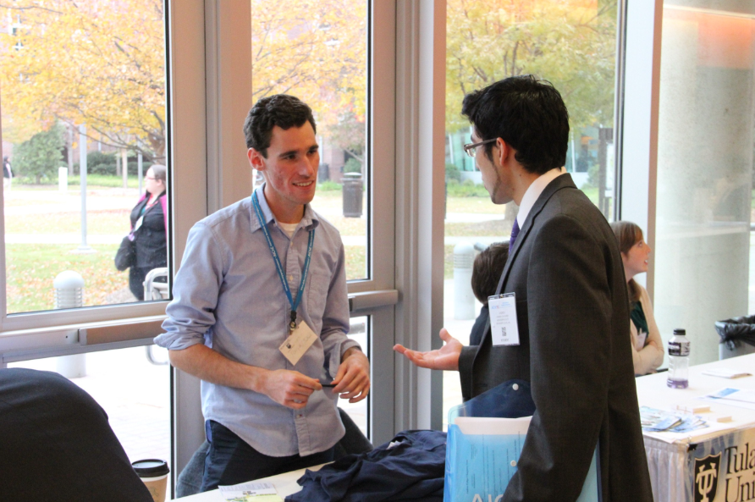
AIChE® Communities

Slide 2
AIChE Engage
Student Central
Connect with your peers and participants in discussions on AIChE Engage
Provide or seek advice on current school projects, on applying for graduate schools, or other topics.
Notes:
This exclusive undergraduate student discussion forum allows you to connect with other AIChE student members from around the world. You can post questions about your chemical engineering studies, career goals, or best practices for your student chapter. You can also help other students by answering their questions and even chat about the upcoming student conferences and other undergraduate student events. You can also find and share helpful resources in the Student Central Library.

Slide 3
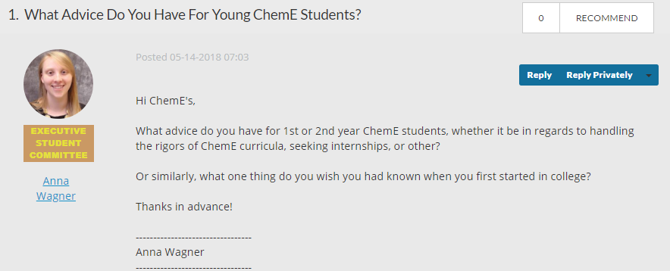
AIChE Engage
Student Central
Check out the Engage Tips and Tricks for a quick start
Download the Engage App
Notes:
Check out the tips and tricks on Engage to help get you started and download the AIChE Engage app on your smartphones

Slide 4
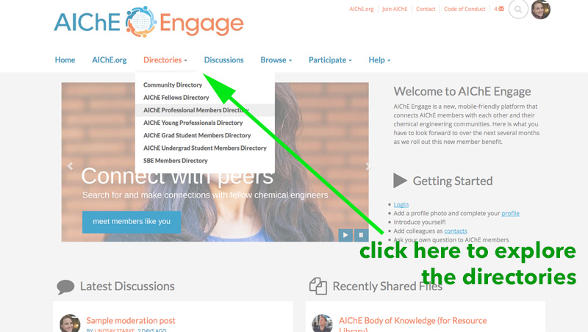
How to use Directory
Search for Chemical Engineers like you in the directory
Notes:
AIChE Engage Directory
Network virtually with the help of AIChE Engage. Did you know you can search the AIChE Engage Directory for specific people or types of people and connect with them? Check out the Engage Quick Start Guide and learn how to use the member directory to find contacts and add them to your AIChE contact list.
How to Find and add AIChE members contacts within AIChE Engage:
First, you can search an AIChE Engage Directory for specific people or types of people. You can find our directories in the top navigation bar. Click on the directory you wish to search through.
You'll then be prompted to enter in a person's name, an email or a company name. You can also use the Advanced Search tab to find people by location, job function, and industry classification. Click Find Members for a list of members who fit that description.
A list of members who fit that description will then appear. That list will show an option in blue next to each person's name to "Add as Contact." Click that button and they will receive a notification that you wish to add them as a contact. They will have to then accept your request for them to appear on your contact list.
You can find your contact list through your AIChE Engage member profile under the My Connections button. Everyone who you have added as a contact and who has accepted the contact request will be listed in your contact list.

Slide 5
Community Counts
Connect with Like-Minded Engineers
Find peers driven by the same interest
Interact with different Technical Communities
Become a part of societal impact communities
  ChEs with disability
  LGBTQ+ Engineers
  Women in chemical engineering
Notes:
AIChE members have created even more of these communities, allowing like-minded engineers all over the world to exchange knowledge, advance shared technical and research interests, and combine energies to pursue worthwhile societal, professional, and personal development objectives.

Slide 6
Volunteer Central
Get involved with the global community of chemical engineers
Complete your Volunteer Profile to get matched with volunteering opportunities like brainstorming discussion topics for AIChE’s CEP magazine
Notes:
Whether you are helping to coordinate an event, write a blog post, or chair a committee, volunteers are integral to AIChE’s success. Make sure you're opted into Volunteer Central and complete your profile to begin searching opportunities today.
AIChE can match you with your future Volunteer opportunities for which you are both qualified and interested.

Slide 7

Follow AIChE on Social Media @ChEnected
Notes:
Make sure to follow AIChE on social media!

